Slide 1
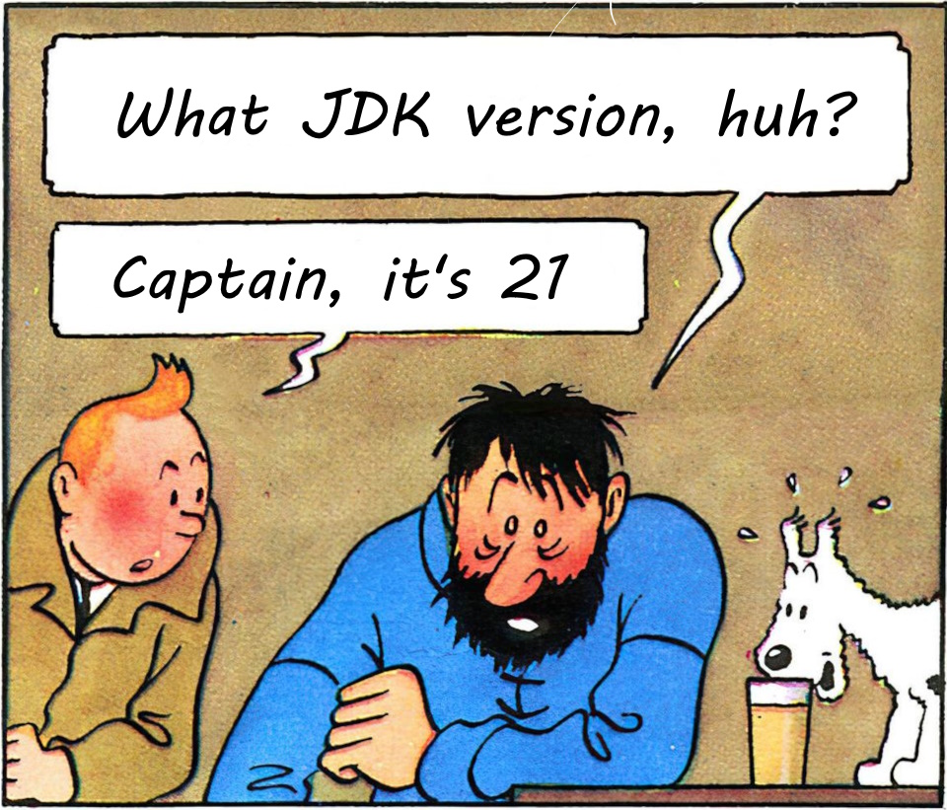

JDK 18 - JDK 21: What’s new?
Notes:
JDK 21 – What’s new?

Slide 2


Speaker:
Ivan Babanin
Lead Software Engineer
Notes:
Hi everyone, my name is Ivan and I work as lead software engineer.

Slide 3

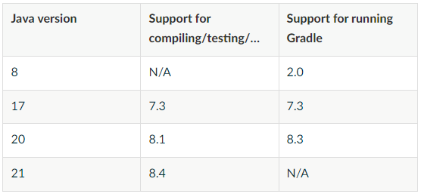






JDK distributions
JDK 21 LTS
Released on 19 Sep 2023
Vendors
Tools
OpenJDK – 19 Sep 2023
Oracle JDK – 19 Sep 2023
Oracle GraalVM for JDK – 19 Sep 2023
Amazon Corretto – 21 Sep 2023
Microsoft Build of OpenJDK – 28 Sep 2023
Eclipse Temurin (ex AdoptOpenJDK) – 10 Oct 2023
IntellIJ IDEA 2023.2.2 – 13 Sep 2023
Maven doesn’t care
Gradle 8.4 – 04 Oct 2023, but…
Notes:
JDK 21 released a couple of months ago.
(Vendors)
By this time all major vendors released their distributions. What about tools?
…
Some of you might wonder what LTS is?

Slide 4

Release cadence
Releases
LTS – Long Term Support
Few thing to keep in mind:
Java does not have LTS versions, LTS is a paid service of extended support offered by various companies
Any company can offer LTS for any version, but almost all follow Oracle's choice
Most LTS services are derived from OpenJDK Updates projects – only backporting
Java SE 5 | 29th September 2004
Java SE 6 | 11th December 2006
Java SE 7 | 28th July 2011
Java SE 8 (LTS) | 18th March 2014
Java SE 9 | 21st September 2017
Java SE 10 | 20th March 2018
Java SE 11 (LTS) | 25th September 2018
Java SE 12 | 19th March 2019
Java SE 13 | 17th September 2019
Java SE 14 | 17th March 2020
Java SE 15 | 16th September 2020
Java SE 16 | 16th March 2021
Java SE 17 (LTS) | 14th September 2021
Java SE 18 | 22nd March 2022
Java SE 19 | 20th September 2022
Java SE 20 | 21st March 2023
Java SE 21 (LTS) | 19th September 2023
Java SE 22 | March 2024
Java SE 23 | September 2024
Java SE 24 | March 2025
Java SE 25 (LTS) | September 2025
Java developers have two “pills”:
Buy LTS
Use the current version
Notes:
LTS – is long term support. Up until JDK 10 there was no special schedule, however after it we have JDK release every six month and LTS every two years, so next LTS will be in September.
Companies and developers like to stick to LTS releases but
(click)
But Java language doesn’t have LTS version. It’s all vendors who provides paid support.
(click)
Companies are free to mark any version as LTS, but everyone follows Oracle
(click)
LTS – that’s mostly security patches, back in JDK 8 days, hundreds of engineers were working on keeping LTS updated, however with new release schedule major activities are tied to new release so…
(click)
….
Okay, let’s check out what’s new in JDK 21.
From Ron Pressler: https://www.reddit.com/r/java/comments/ho4wxe/comment/fxfxkd0/?utm_source=share&utm_medium=web2x&context=3

Slide 5
JDK 21
Released
Preview
JEP 431: Sequenced collections
JEP 439: Generational ZGC
JEP 440: Record patterns
JEP 441: Pattern matching for switch
JEP 444: Virtual threads
JEP 449: Deprecate Windows 32-bit x86 Port
JEP 451: Prepare to Disallow the Dynamic Loading of Agents
JEP 452: Key Encapsulation Mechanism API
JEP 430: String Templates (Preview)
JEP 442: Foreign Function & Memory API (Third Preview)
JEP 443: Unnamed Patterns and Variables (Preview)
JEP 445: Unnamed Classes and Instance Main Methods (Preview)
JEP 446: Scoped Values (Preview)
JEP 453: Structured Concurrency (Preview)
Incubator
Since JDK 17
JEP 448: Vector API (Sixth Incubator)
JEP 400: UTF-8 by Default
JEP 408: Simple Web Server
JEP 413: Code Snippets in Java API Documentation
JEP 416: Reimplement Core Reflection with Method Handles
JEP 418: Internet-Address Resolution SPI
JEP 421: Deprecate Finalization for Removal
JEP 422: Linux/RISC-V Port
Notes:
Here is a list of JEP’s released in JDK21. JEP stands for JDK Enhancement-Proposal and typically it should be drafted for any work which requires 2+ week or it significant change to the JDK.
(after preview)
Preview JEPS are mostly a language or VM feature that is fully specified, implemented, and yet impermanent. It is available in a JDK feature release to provoke developer feedback based on real world use.
Preview == @Deprecated
(after incubator)
Incubator – are early versions of VM-level features, which can be risky, incomplete, unstable: if a preview feature should be at least 95% “done” then an experimental feature is considered 25% “done”
Experimental APIs distributed in a form of separate modules with names prefixed with “jdk.incubator.”
(after JDK 17)
In the report, we will only look at the JEP that the developer is working via some sort of API or it somehow affects development. We'll go in ascending order.

Slide 6

What’s next?
JEP 400: UTF-8 by Default
JEP 408: Simple Web Server
JEP 413: Code Snippets in Java API Documentation
JEP 431: Sequenced collections
JEP 439: Generational ZGC
JEP 440: Record patterns
JEP 441: Pattern matching for switch
JEP 444: Virtual threads

Slide 7









JEP 400: UTF-8 by Default
APIs with Charset
…
Current issues
Developers rarely specify encoding explicitly:
“hello.txt” with following content encoded with UTF-8 on MacOS:こんにちは
java.io.FileReader(“hello.txt”) -> “こんにちは” (macOS)
java.io.FileReader(“hello.txt”) -> “ã?“ã‚“ã?«ã?¡ã? ” (Windows (en-US))
java.io.FileReader(“hello.txt”) -> “縺ォ縺。縺ッ” (Windows (ja-JP)
Property files, starting from JDK 9, are using UTF-8
java.nio.file.Files methods are hardcoded with UTF-8
Some of the methods of URLEncoder/Decoder w/o encoding are deprecated
Windows uses Windows-1251, while Linux and Mac - Unicode
Charset.defaultCharset() looks for argument “-Dfile.enconding” which itself uses system locale
Notes:
Standard Java APIs for reading and writing files and for processing text allow a charset to be passed as an argument. A charset governs the conversion between raw bytes and the 16-bit char values of the Java programming language. But the problem is …

Slide 8
JEP 400: UTF-8 by Default
What can we do?
Do nothing
Deprecate all methods without specifying the encoding
Stop Java development and release a new language
Hardcode UTF-8 everything
Notes:
Do nothing! Why not? Sometimes it's better to wait a bit longer to gather more data and statistics before making the right decision. But it will not solve the problem
(click)
You can deprecate methods without encoding parameters and say, "Look, developers, now you have to be sure to specify the encoding". Apart from the fact that it will make your code longer, I afraid all library developers instead of propagating it to the user will go hardcoding their encoding value.
(click)
You can nail Java development and release a new language :) Of course it's a joke, but Kotlin and other new languages already have everything in place. This is not a solution for us: there are a lot of systems that run on Java, and the language itself is more alive than any other.
(click)
We could just hardcode UTF-8 or any other value everywhere, but then we'd break backwards compatibility. And Java is very famous for its commitment to preserving contracts.
(click)
And so we came to the …. -

Slide 9

JEP 400 UTF-8 by Default
JDK 18
Notes:
JEP 400 - it's a trade-off, a choice between different options.

Slide 10








JEP 400: UTF-8 by Default
In JDK 17:
New -Dnative.encoding argument, which is always equal to system locale
In JDK 18:
Methods of java.nio.file.Files are left intact and use UTF-8 by default
Other APIs are using Charset. defaultCharset() which itself use -Dfile.encoding
By default, it’s UTF-8
But if you set -Dfile.encoding=COMPAT, then it will look into -Dnative.encoding, which uses system encoding
Scanner
InputStream{Reader|Writer}
File{Reader|Writer}
Formatter
String.getBytes()
java.nio.files.Files
Charset.defaultCharset()
-Dfile.encoding
“COMPAT”
Empty or “UTF-8”
-Dnative.encoding
UTF-8
System locale
Notes:
First things first, in JDK 17 we added new argument. It’s quite funny that it always equals to system locale, and you can not override it.
(final)
Okay, looks like problem solved and if after migration to JDK 18 you suddenly found out that your file API started returning some gibberish, you probably need to reexamine your code or set file encoding argument to compatibility value.

Slide 11


What’s next?
JEP 400: UTF-8 by Default
JEP 408: Simple Web Server
JEP 413: Code Snippets in Java API Documentation
JEP 431: Sequenced collections
JEP 439: Generational ZGC
JEP 440: Record patterns
JEP 441: Pattern matching for switch
JEP 444: Virtual threads

Slide 12
JEP 408: Simple Web Server
Let’s say you need a server which:
Easy setup and minimal functionality
No framework: Jetty, Netty, etc.
No production server: Apache Tomcat, NGINX, etc.
No CGI or servlet-like functionality is available
Can be run through command-line
Has small API for programmatic creation and customization
A couple of years ago, my choice would be:
python -m SimpleHTTPServer 9000
python -m http.server 9000
Notes:
Looking for a small web server for serving static content?

Slide 13
JEP 408 Simple Web Server
JDK 18

Slide 14
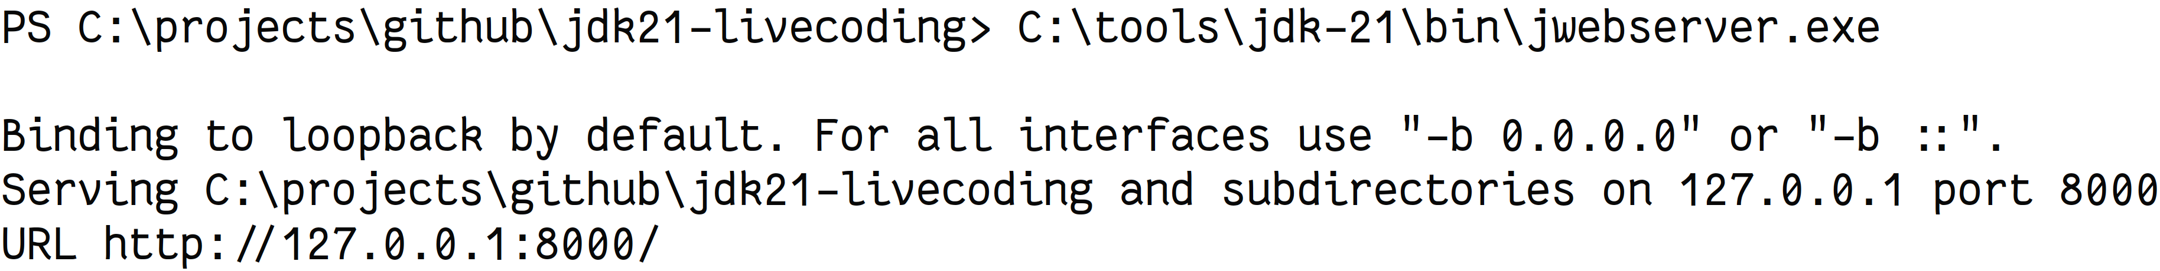
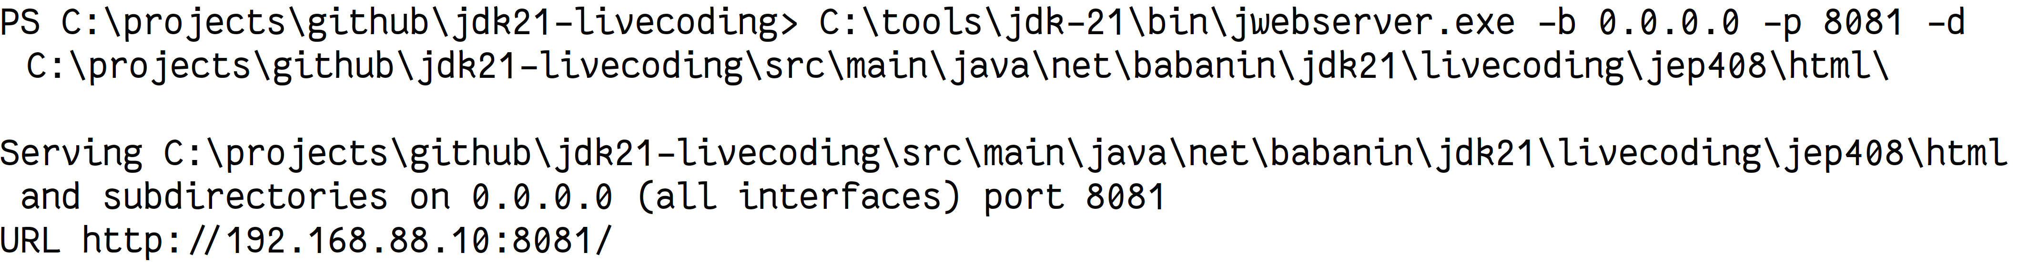
JEP 408: Simple Web Server
Starting from JDK 18, I use: Simple Web Server
Can be run with custom port and path:
Or programmatically:
Notes:
(…)
In general, can be very useful if you need to quickly download files from the server, or to see test reports or perf tests.

Slide 15

What’s next?
JEP 400: UTF-8 by Default
JEP 408: Simple Web Server
JEP 413: Code Snippets in Java API Documentation
JEP 431: Sequenced collections
JEP 439: Generational ZGC
JEP 440: Record patterns
JEP 441: Pattern matching for switch
JEP 444: Virtual threads

Slide 16
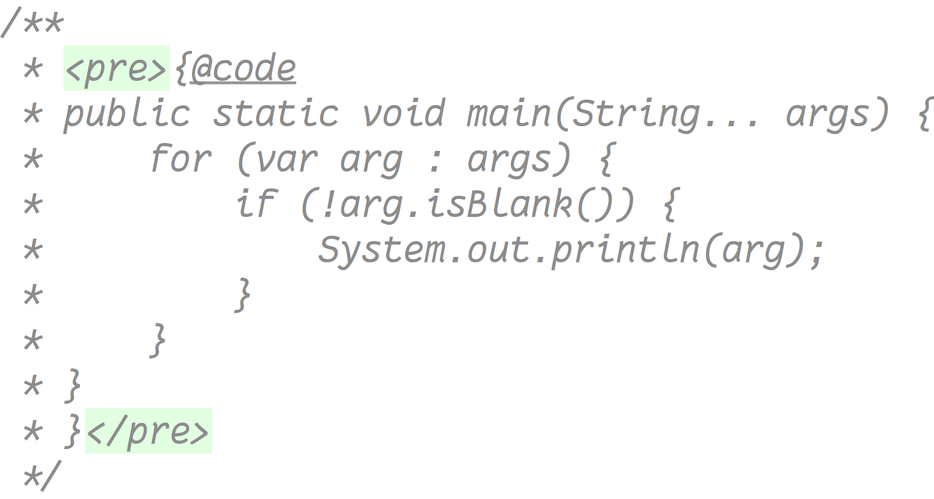
JEP 413: Code Snippets in Java API Documentation
Notes:
Let's say you are a library developer, and you want to add code samples to your javadoc. before JDK 18, the only solution was to use the HTML tag for preformatted text:

Slide 17
JEP 413 Code Snippets in Java API Documentation
JDK 18
Notes:
Luckily we have a new JEP released in JDK 18, which allows adding code inside the documentation that will be included in the Java Docs, both from inline code or from external files.

Slide 18
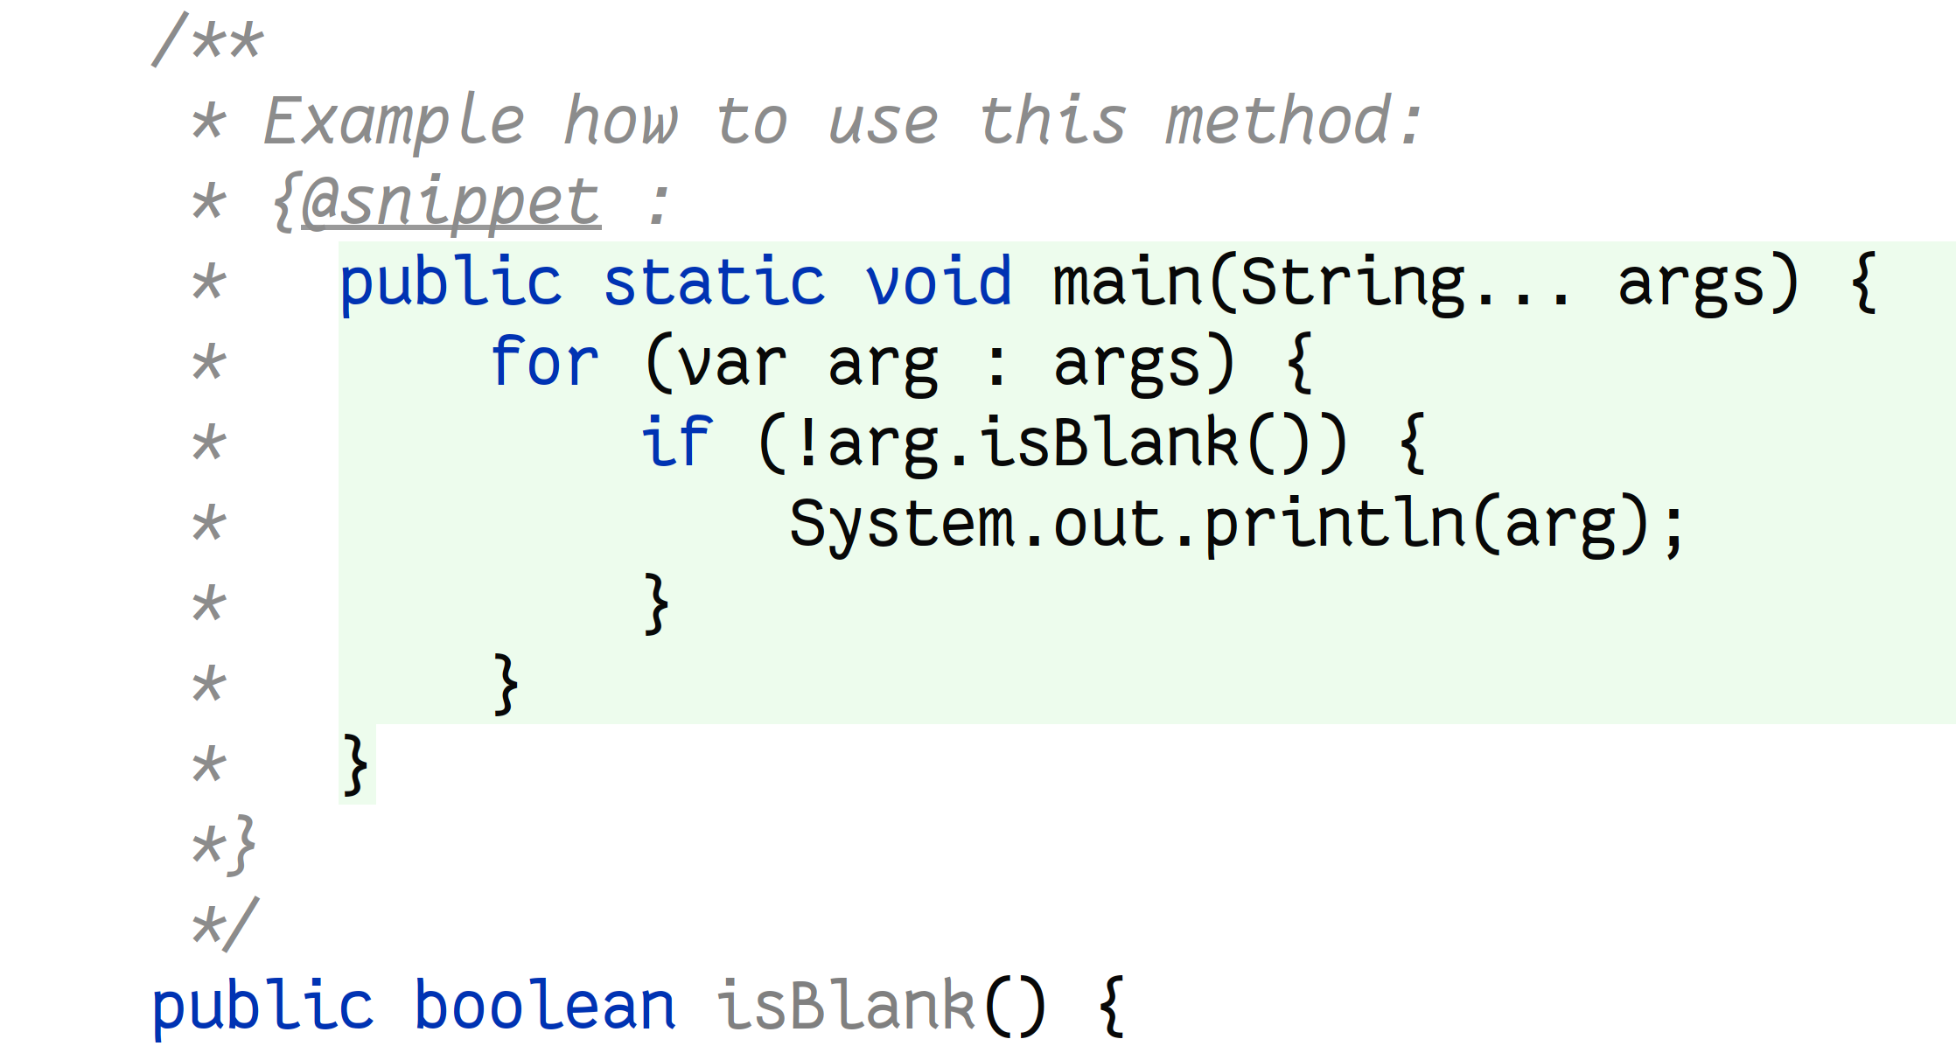
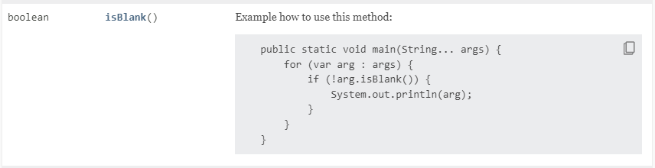
JEP 413: Code Snippets in Java API Documentation
Code
JavaDoc

Slide 19
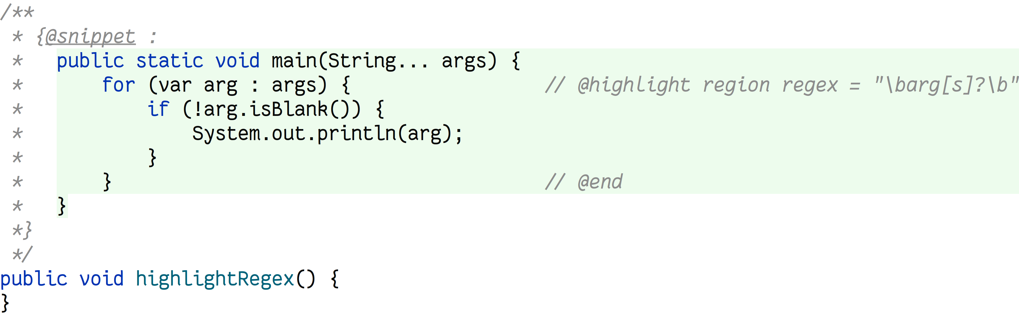

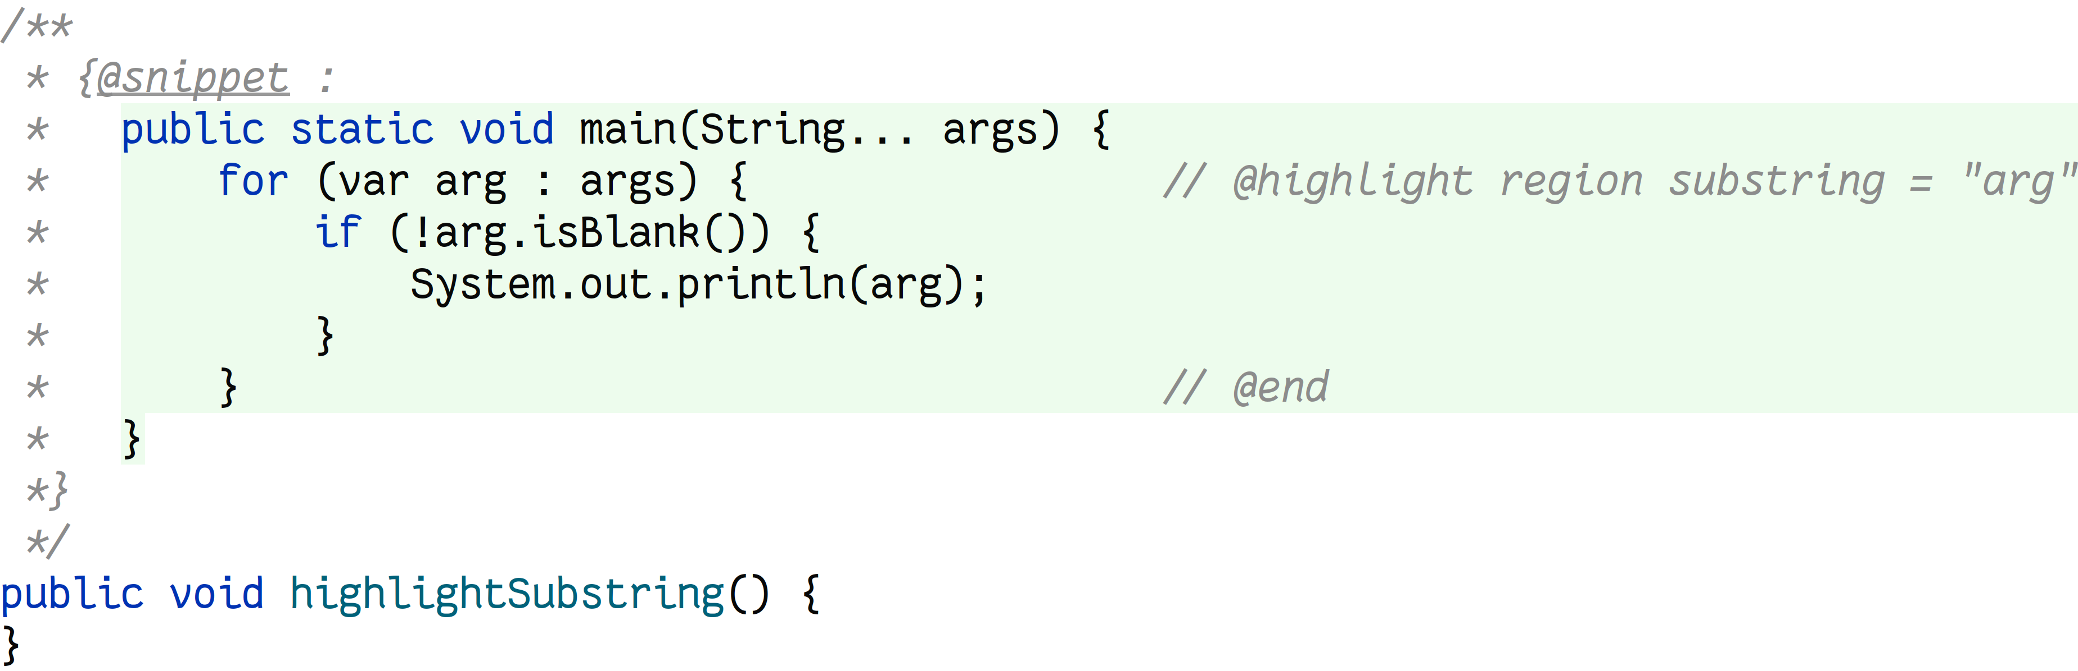

JEP 413: Code Snippets in Java API Documentation
Code
JavaDoc

Slide 20
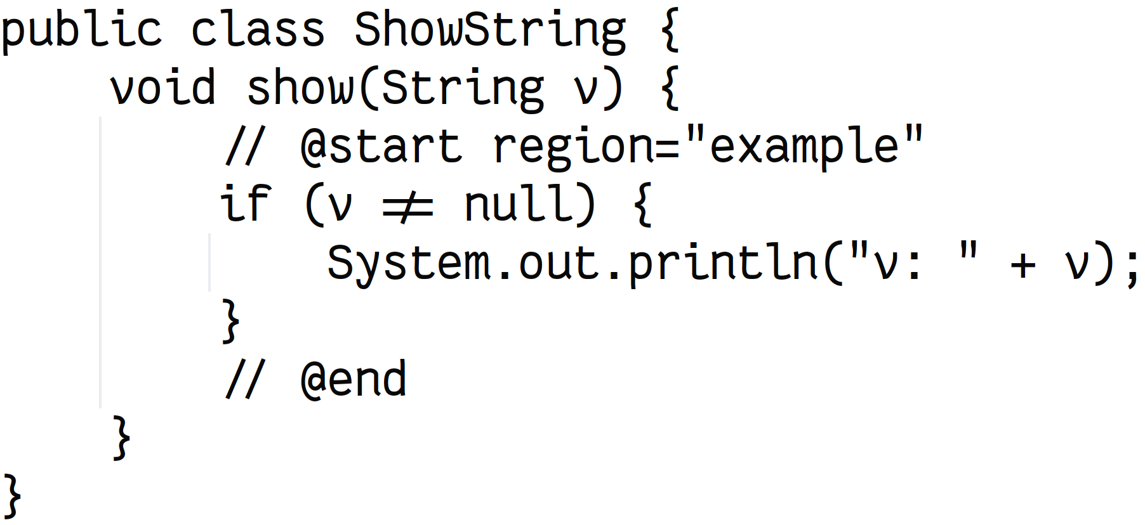
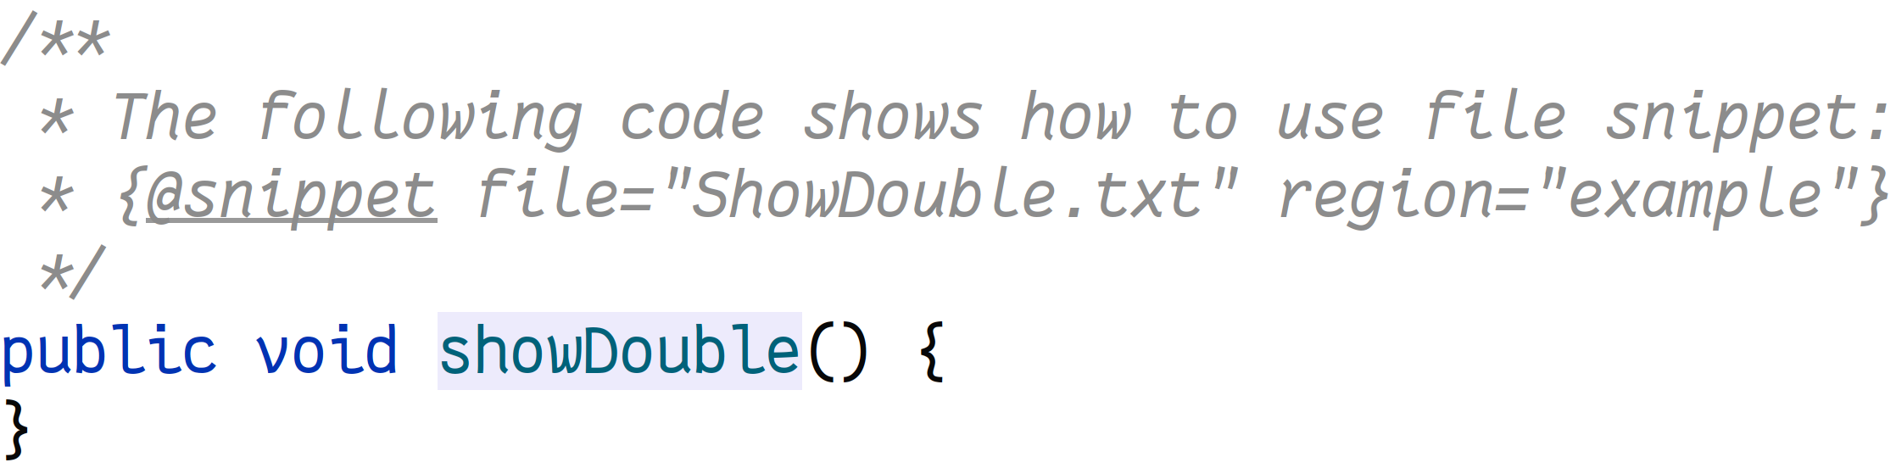
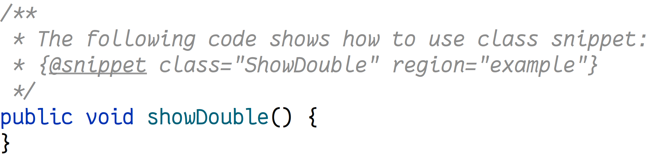
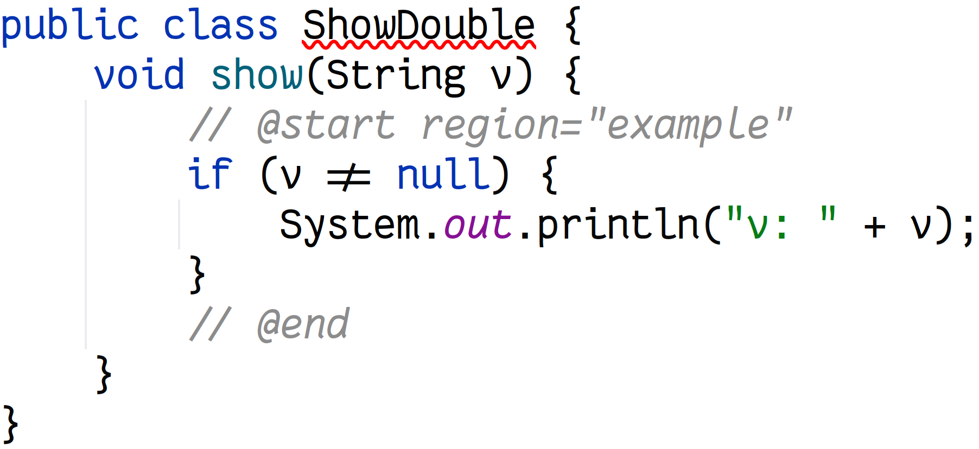

JEP 413: Code Snippets in Java API Documentation
Code
ShowDouble.txt
ShowDouble.java
JavaDoc

Slide 21
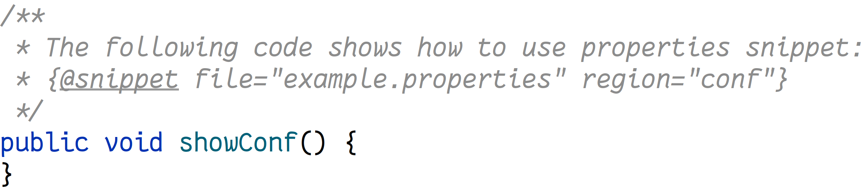
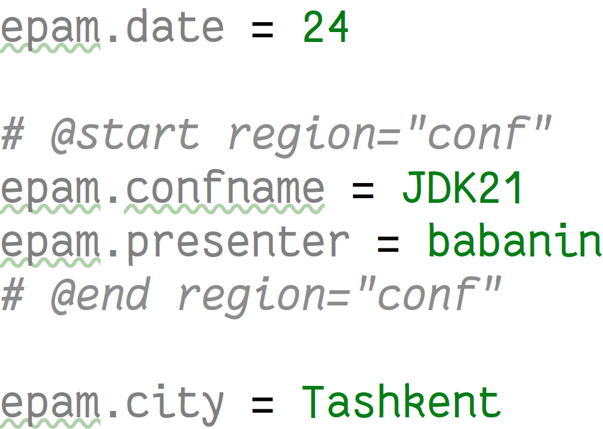
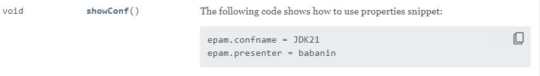
JEP 413: Code Snippets in Java API Documentation
Code
example.properties
JavaDoc

Slide 22
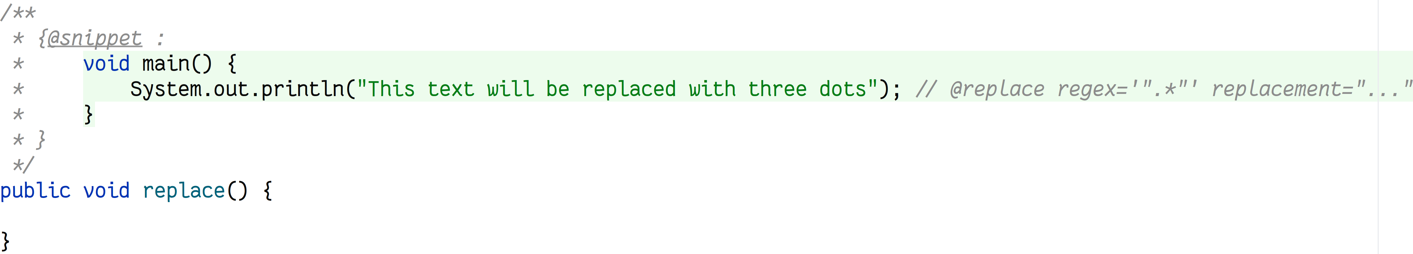
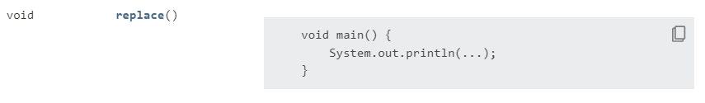
JEP 413: Code Snippets in Java API Documentation
Code
JavaDoc

Slide 23
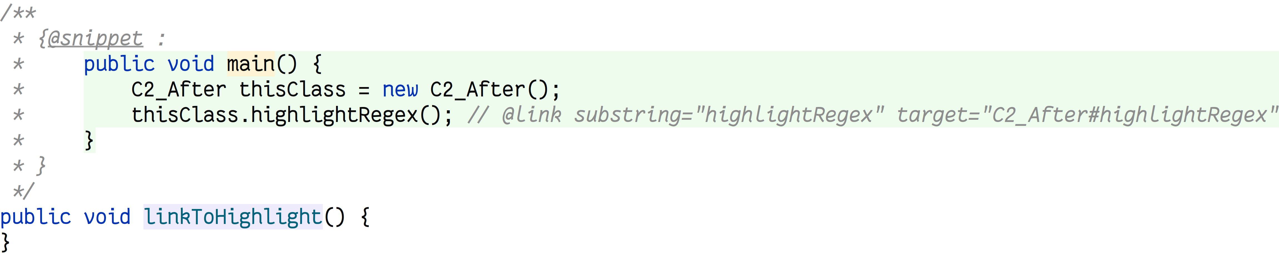
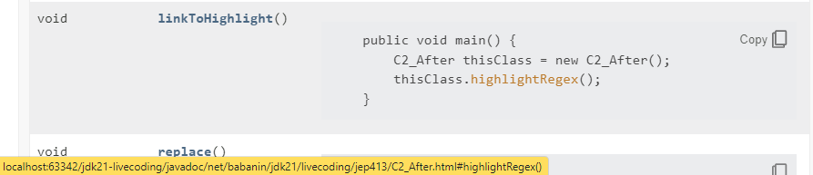
JEP 413: Code Snippets in Java API Documentation
Code
JavaDoc

Slide 24
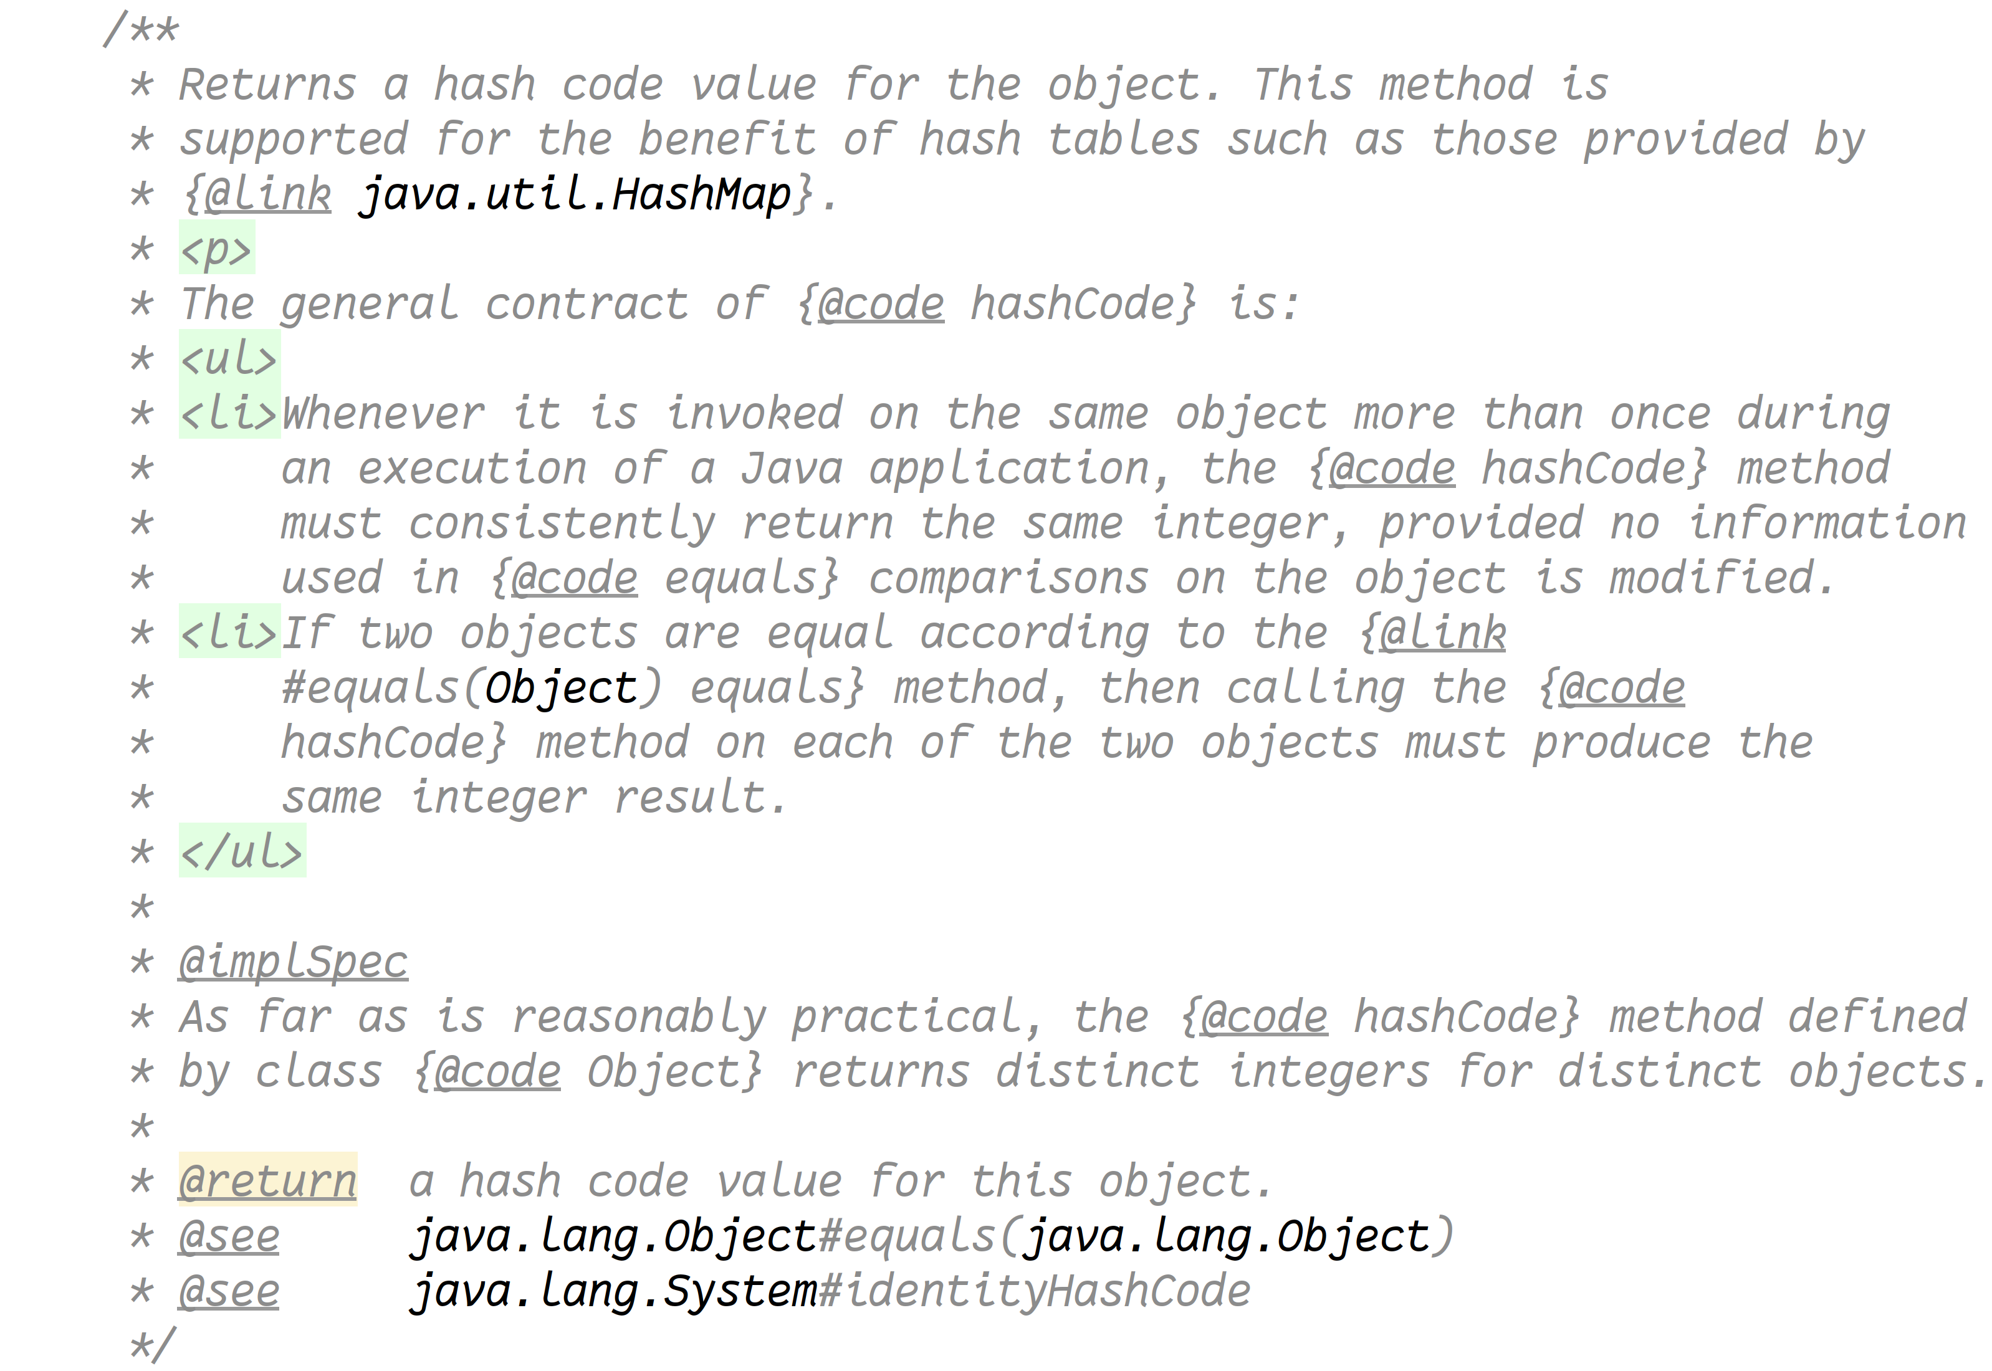
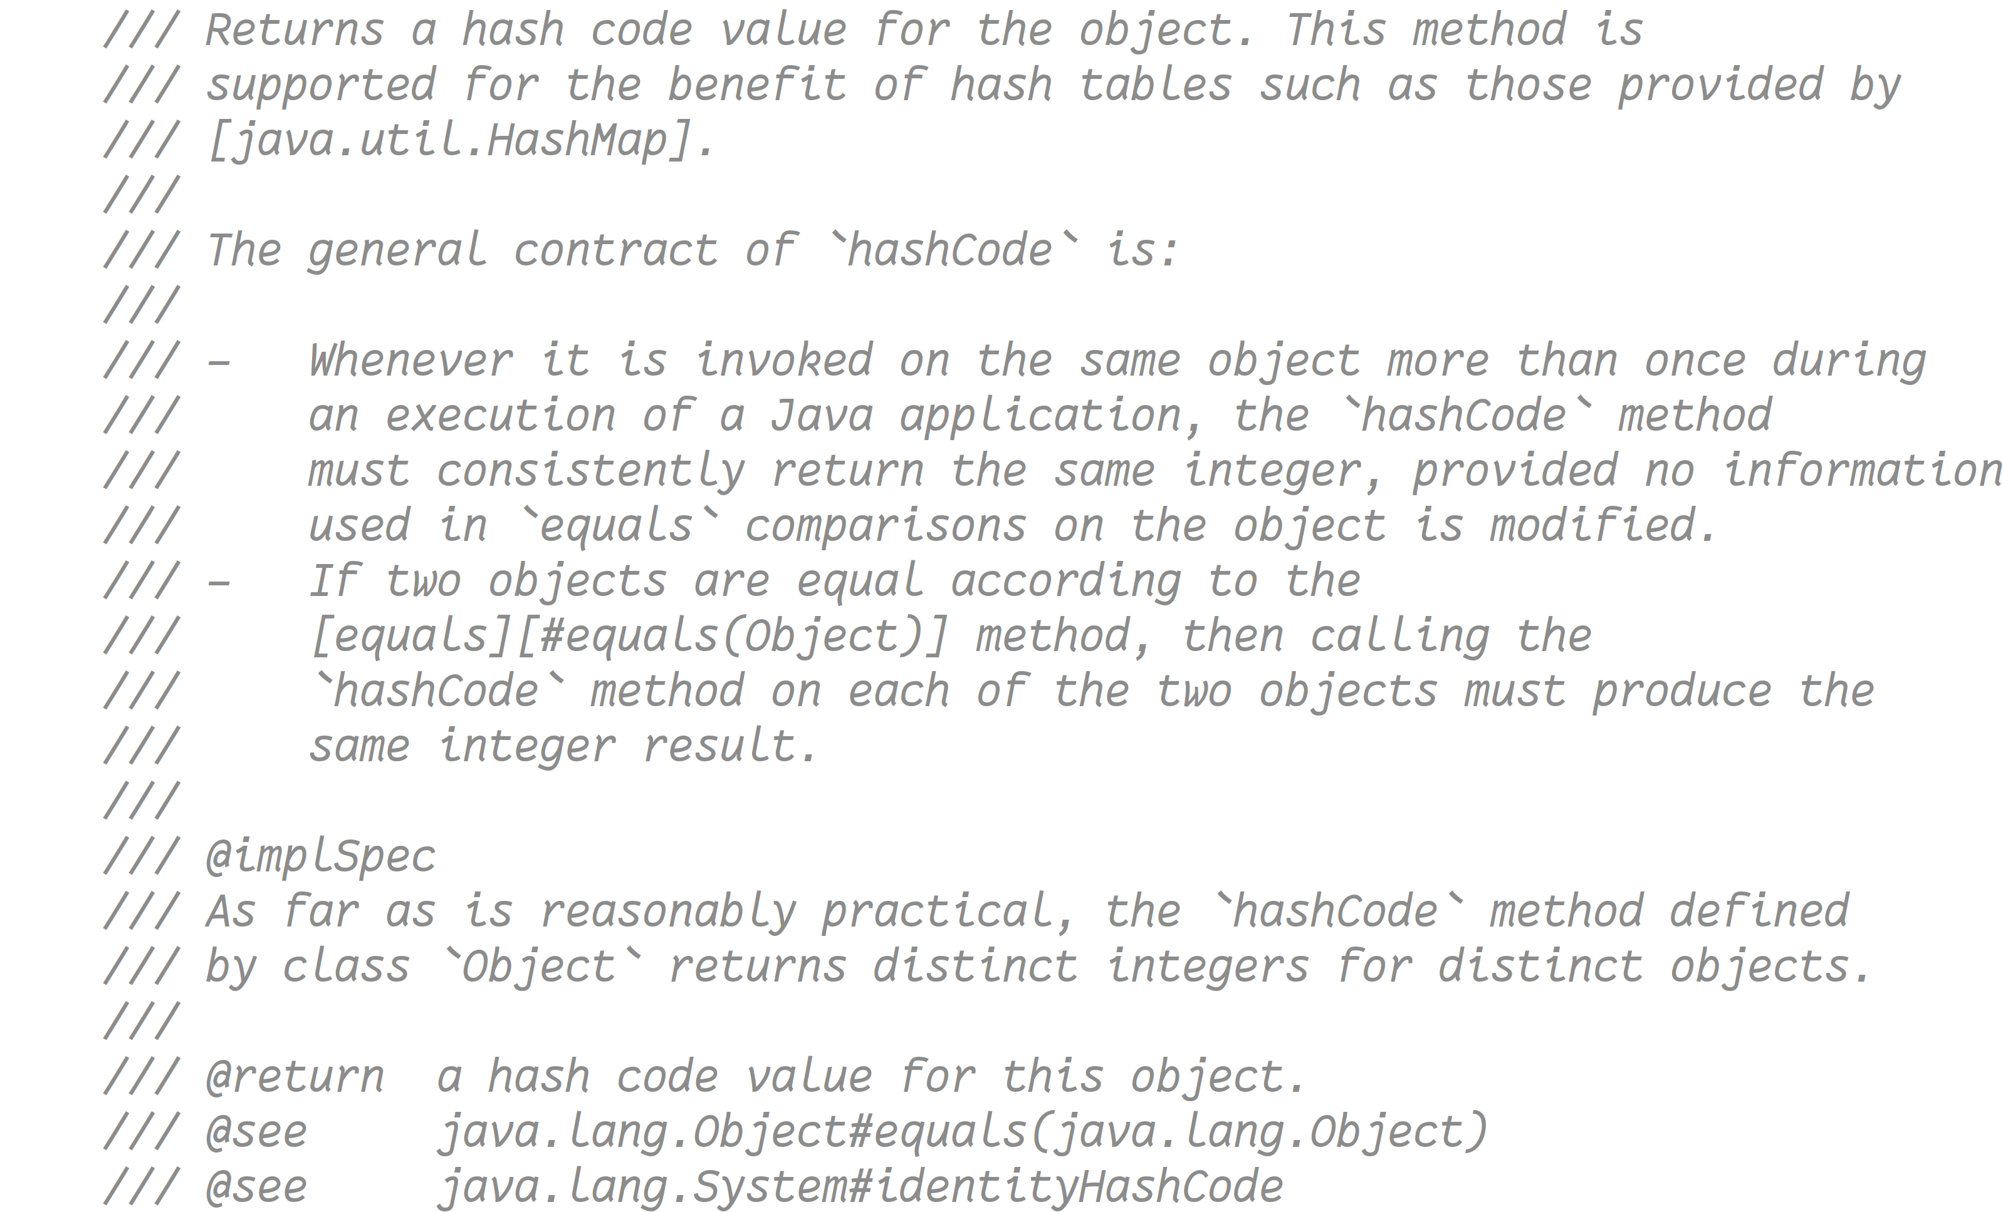
JEP 413: Code Snippets in Java API Documentation
Current
Proposed
Notes:
I've also seen a draft to add a new three slash comment type with markdown support.

Slide 25




What’s next?
JEP 400: UTF-8 by Default
JEP 408: Simple Web Server
JEP 413: Code Snippets in Java API Documentation
JEP 431: Sequenced collections
JEP 439: Generational ZGC
JEP 440: Record patterns
JEP 441: Pattern matching for switch
JEP 444: Virtual threads

Slide 26
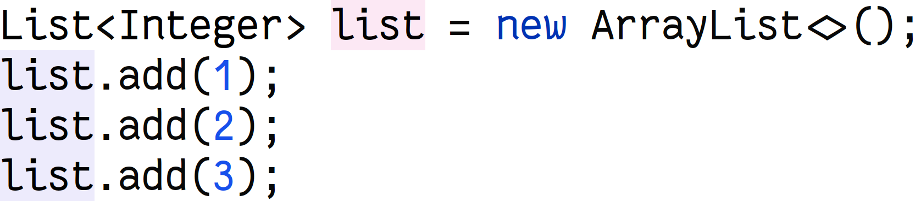
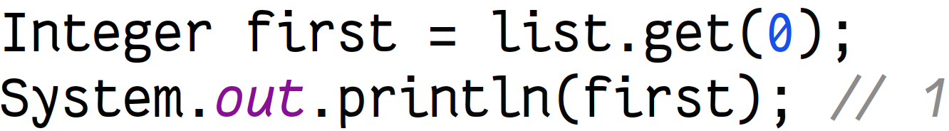
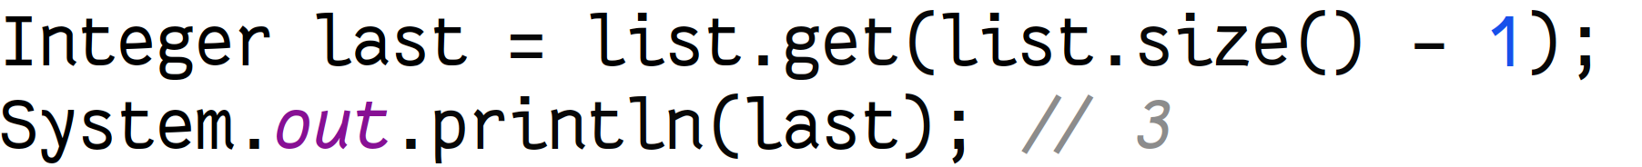
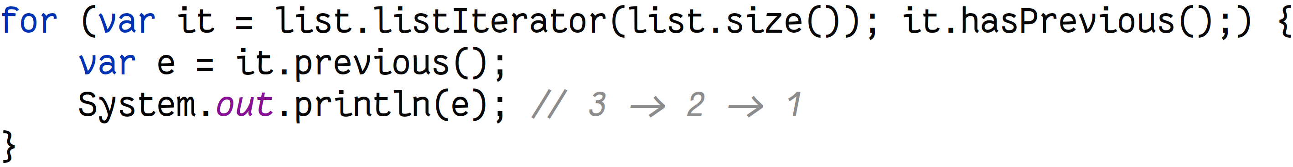
JEP 431: Sequenced collections
Notes:
Collections in Java have always lacked an ordered approach….
(before reverse)
Another problem with collections has been trying to get the elements in a reversed order,

Slide 27
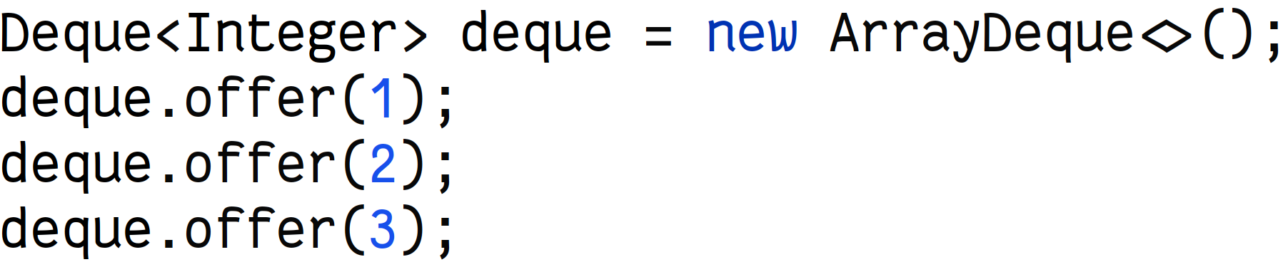
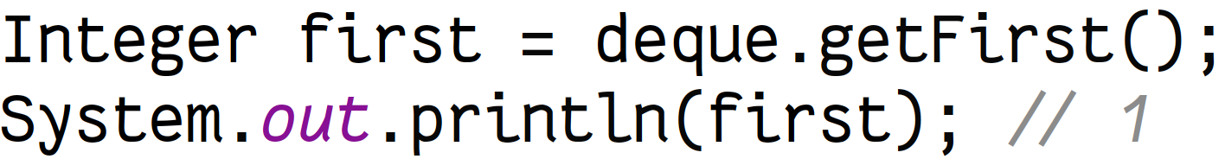
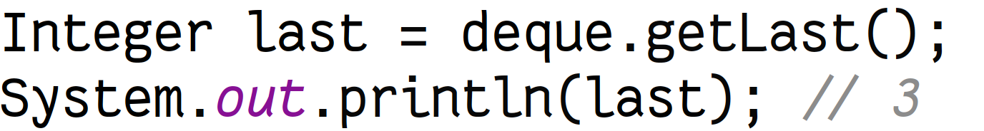
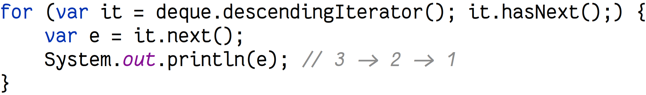
JEP 431: Sequenced collections

Slide 28
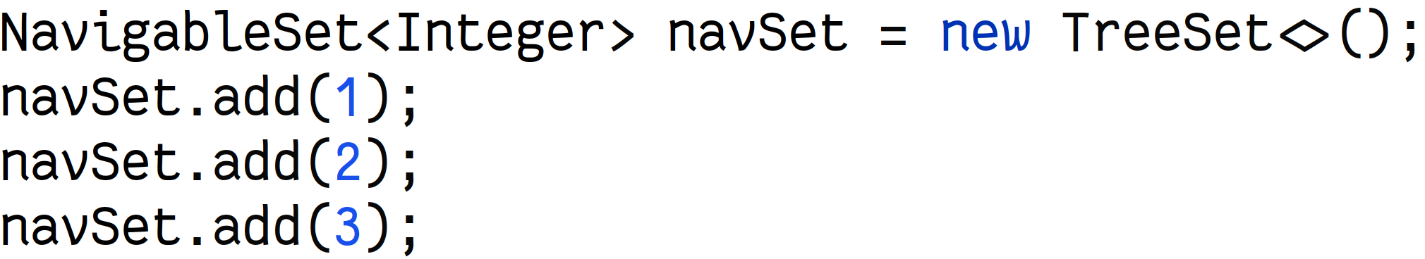
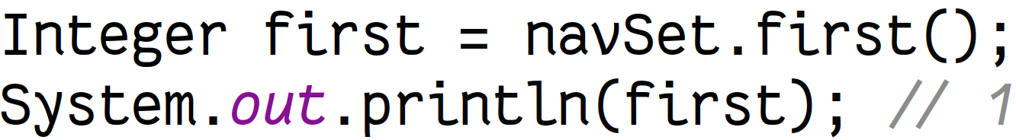
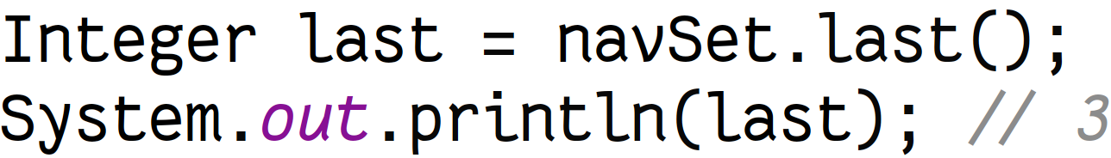
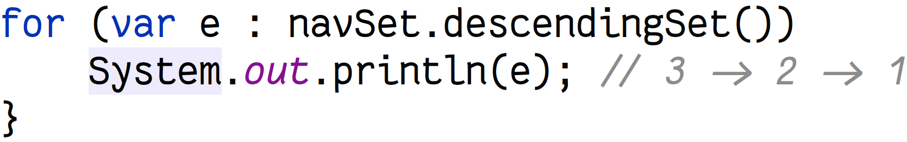
JEP 431: Sequenced collections

Slide 29
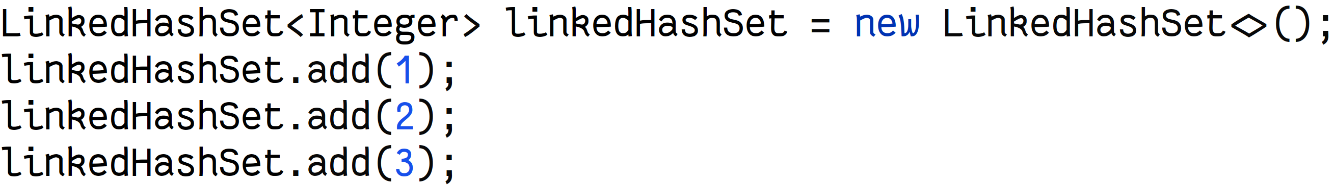
JEP 431: Sequenced collections
Notes:
(final)
Cognitive complexity and lack of supp

Slide 30
JEP 431 Sequenced Collections
JDK 21

Slide 31
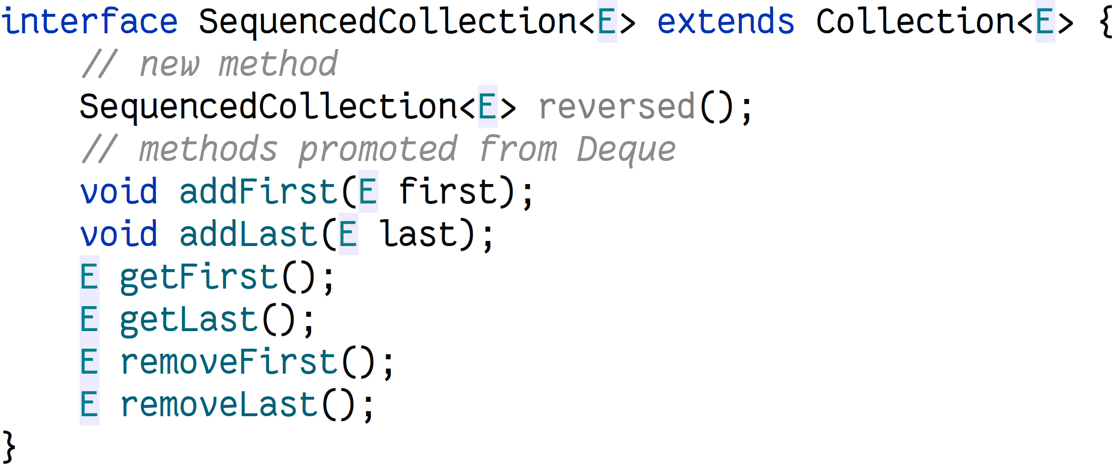
JEP 431: Sequenced collections

Slide 32
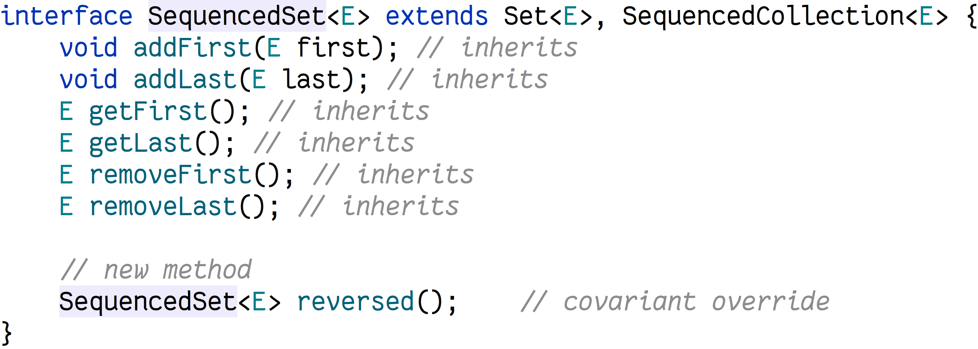
JEP 431: Sequenced collections

Slide 33
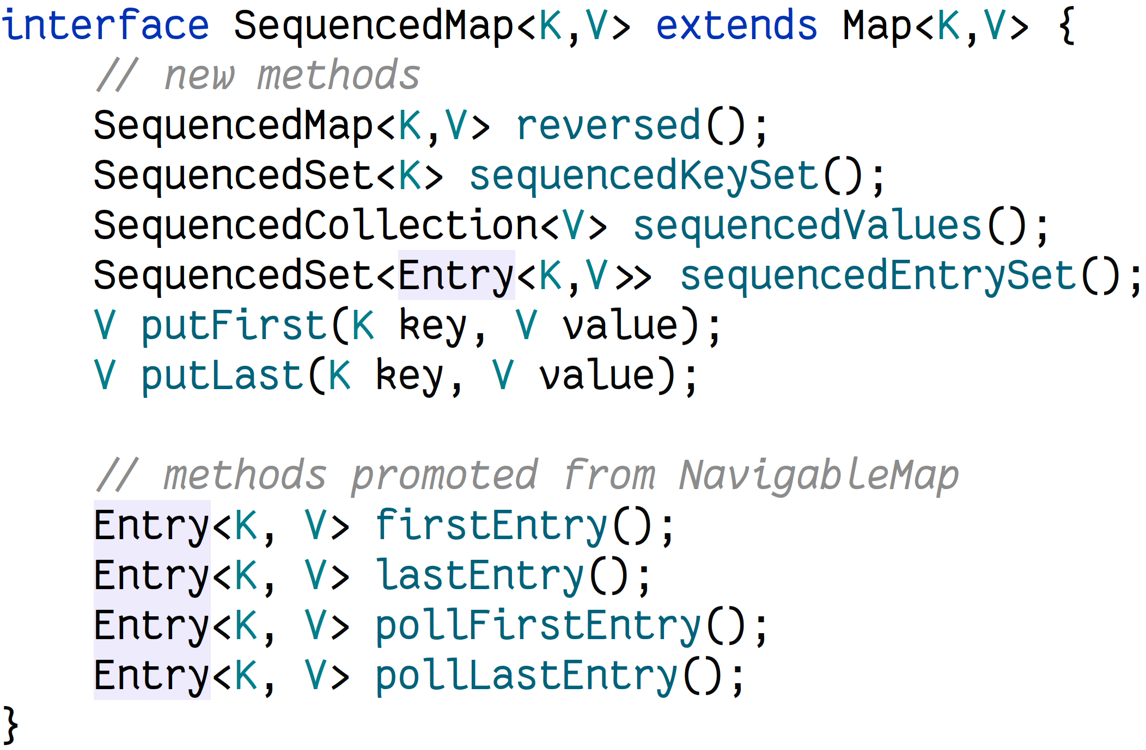
JEP 431: Sequenced collections

Slide 34
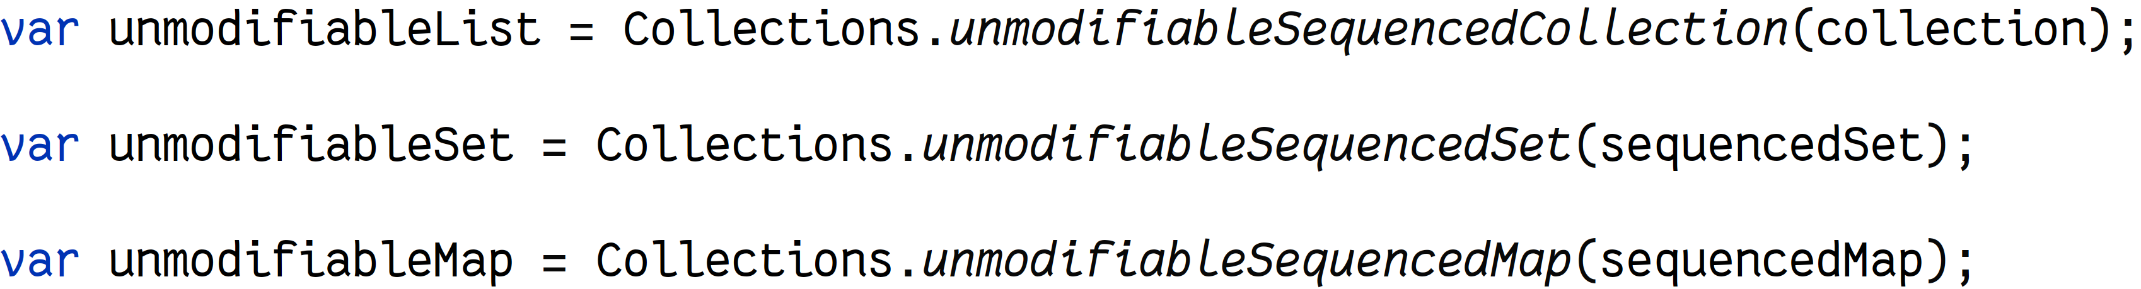
JEP 431: Sequenced collections

Slide 35
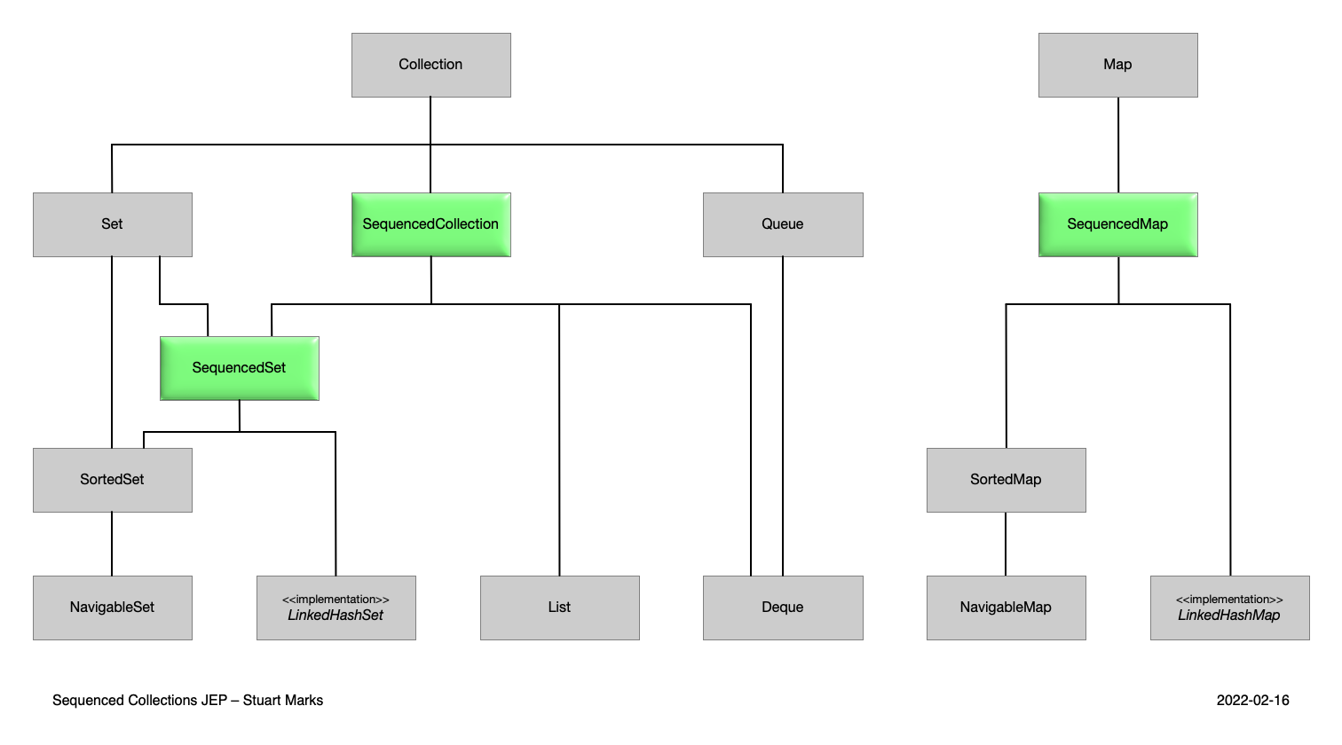
JEP 431: Sequenced collections
Notes:
The three new interfaces defined on previous slides fit neatly into the existing collections type hierarchy
(…)
However, there are a couple of quirks which you need to keep in mind…

Slide 36
JEP 431: Sequenced collections
Notes:
If we add existing element as first, of course we will just move it.
(click)
Similar with last.

Slide 37
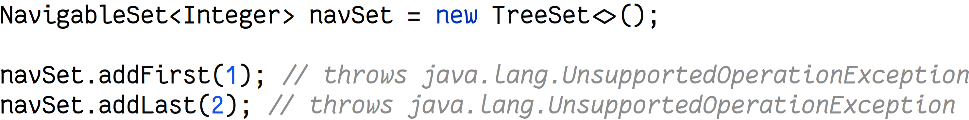
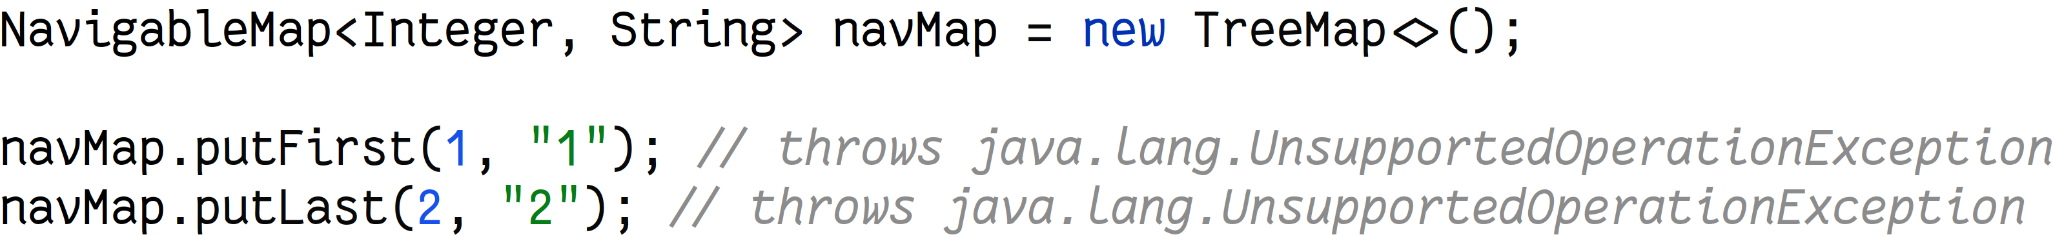
JEP 431: Sequenced collections
Notes:
You might notice – SortedSet / SortedMap have addFirst/addLast.

Slide 38


What’s next?
JEP 400: UTF-8 by Default
JEP 408: Simple Web Server
JEP 413: Code Snippets in Java API Documentation
JEP 431: Sequenced collections
JEP 439: Generational ZGC
JEP 440: Record patterns
JEP 441: Pattern matching for switch
JEP 444: Virtual threads

Slide 39
JEP 439: Generational ZGC
Throughput
The percentage of total time spent in useful application activity versus memory allocation and garbage collection.
Latency
Application responsiveness, which is affected by garbage collection pauses.
Footprint
The working set of a process, measured in pages and cache lines.
Notes:
Deciding which garbage collector to use is not always obvious. It’s important to understand that to make the correct choice you first need to figure out what your main goals are.
Often goals are to optimize for
throughput,
latency
footprint.
The optimal solution would of course be to optimize for all of the above and get the best possible performance in every situation. The collectors strive to be as optimal as possible from every aspect, but they are designed to make different tradeoffs to support different use-cases.

Slide 40
JEP 439: Generational ZGC
Serial GC
Single-threaded. Best suited for single-processor machines. This collector may be the best choice for applications that can tolerate pauses and that create very small heaps.
Parallel GC
Throughput collector. You can use the parallel collector when long pauses are acceptable, such as bulk data processing, batch jobs, etc.
G1
Server-style collector designed for multiprocessor machines with a large amount of memory. The collector tries to achieve high throughput along with short pause times, while requiring very little tuning.
ZGC
Low-latency garbage collector that works well with very large (up to 16 TB) heaps. Concurrent, single-generation, region-based and compacting. It does not stop the execution of application threads for more than 10ms.
… Shenandoah, Epsilon GC, CMS
Notes:
Serial GC - single threaded for small heaps and slow.
(click)
Parallel – throughput.
(click)
G1 – default since JDK 9, but keep in mind that if you are running your application in Docker container, if you allocate small amount of resource (less than 2 cores and 2GB of memory) – JVM will switch to Serial.
(click)
ZGC – low-latency collector. We will talk about it in detail…
(click)
And others …
(…)
Let’s talk about ZGC in detail…

Slide 41
What is ZGC?
ZGC is just a name
Sub-millisecond pauses
Scalable to terabyte heaps
Requires minimal tuning
Region based heap layout
GC pauses mostly for synchronization
Introduced in JDK 11 as experimental
If you are using JDK 11 on Linux, you can enable it by the following command (not recommended)
-XX:+UnlockExperimentalVMOptions -XX:+UseZGC
If you are on Windows – ZGC, as experimental, available starting from JDK 14
Starting from JDK 15, ZGC in production:
Can be enabled using following argument:
-XX:+UseZGC
On MacOS with AArch64 (M1, M2, …) – starting from JDK 17
Notes:
Sub-millisecond pauses – doesn’t stop application threads for more than a millisecond
Scalable to terabyte heaps – basically not matter your max heap size or your current live set you should have minimal pause times
Requires minimal tuning – you should set max heap size and ZGC fill figure out the rest
(click)
Region based heap layout – good flexibility compared to other GCs
Let’s check how GCs have been improved through the JDK releases:

Slide 42
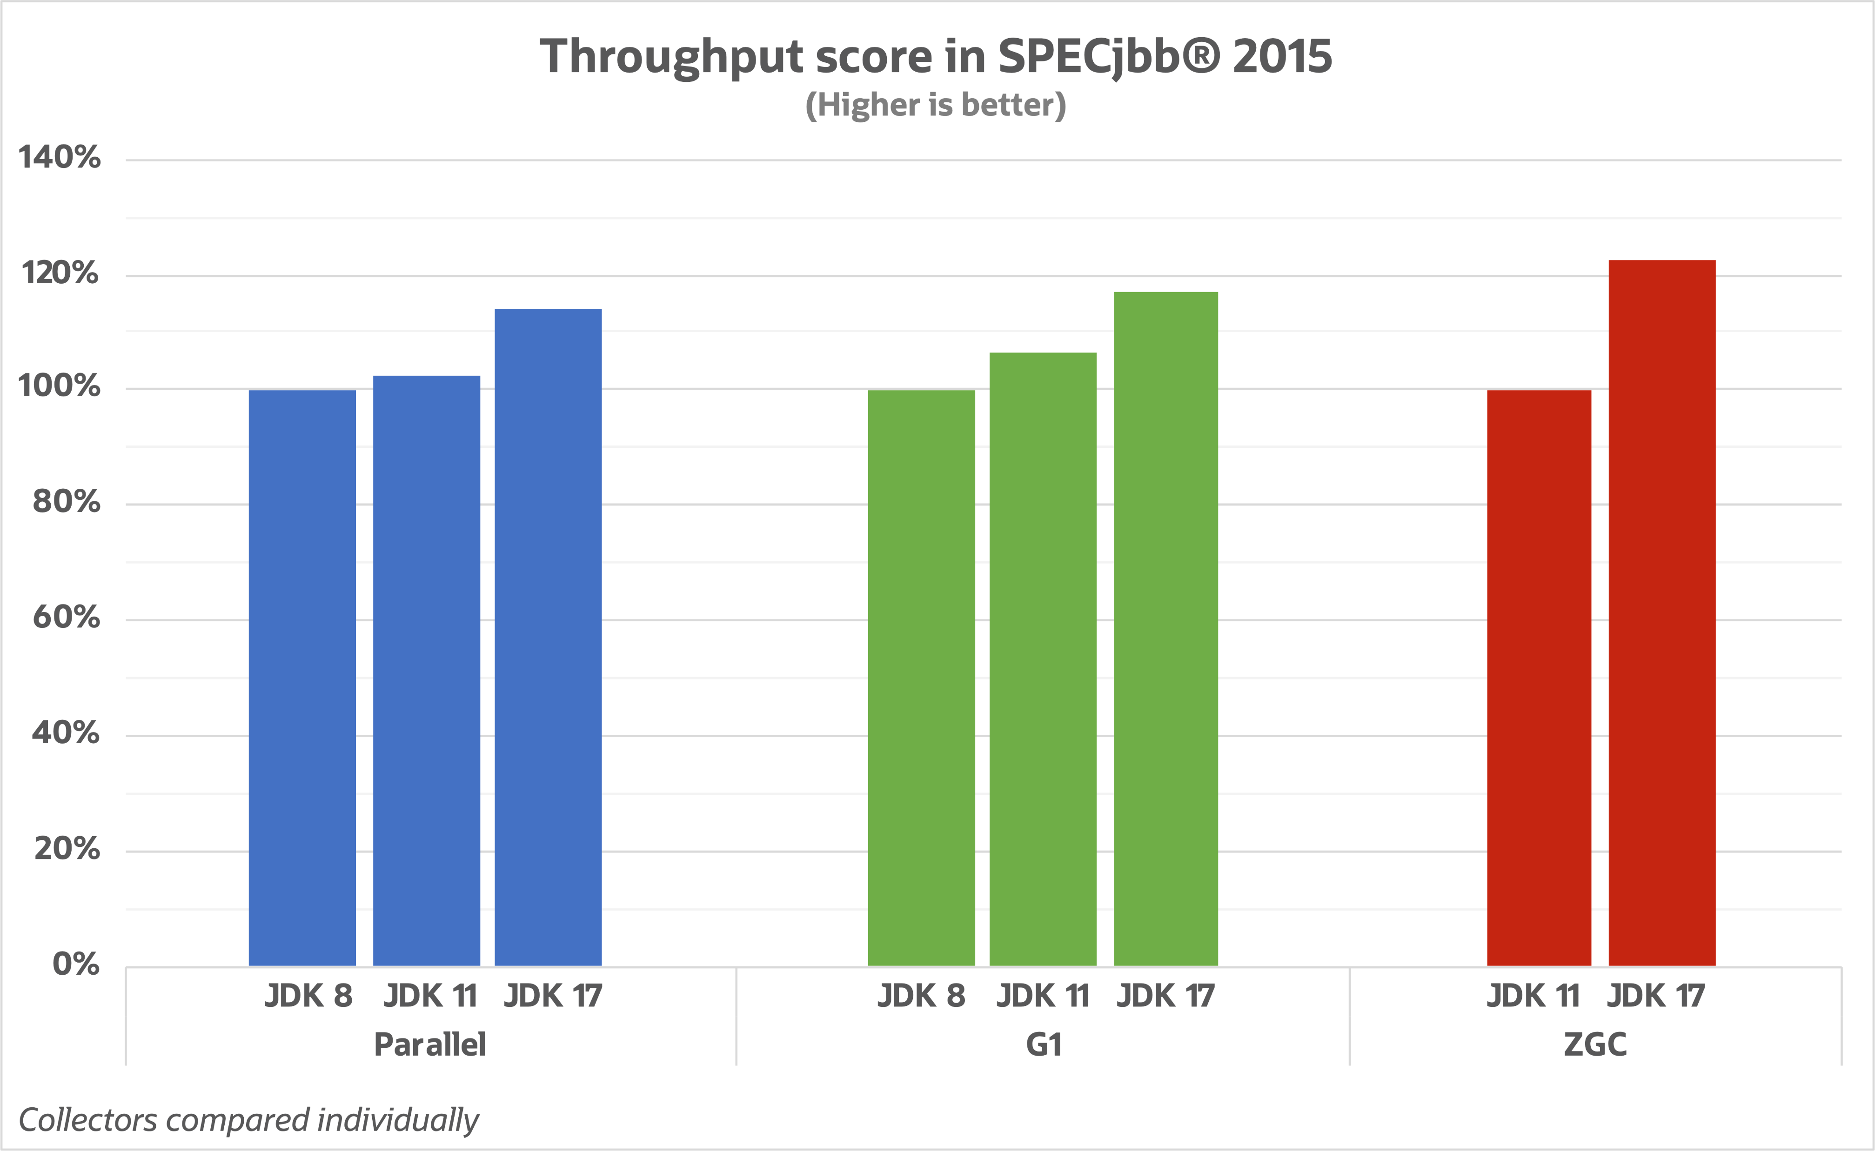
JEP 439: Generational ZGC
https://kstefanj.github.io/2021/11/24/gc-progress-8-17.html
Notes:
Looking at the throughput metric we see that all collectors have improved significantly compared to older releases. ZGC is the one making the biggest improvement in this area.
When it comes to this metric, we should also keep in mind that we are not only measuring GC performance. Other parts of the Java platform, for example the JIT compiler, also contribute to these improvements.

Slide 43
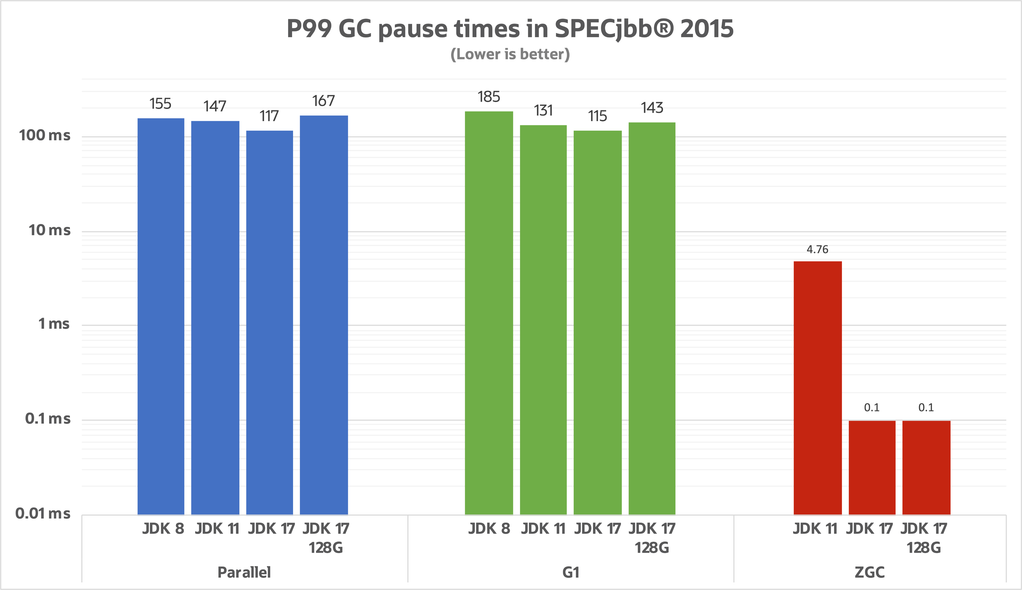
JEP 439: Generational ZGC
https://kstefanj.github.io/2021/11/24/gc-progress-8-17.html
Notes:
Here we look at raw numbers and as we can see ZGC in JDK 17 is way below its goal of sub-millisecond pause times.
G1, with its goal of keeping a balance between latency and throughput, keeps well below its default pause time target of 200 ms.

Slide 44
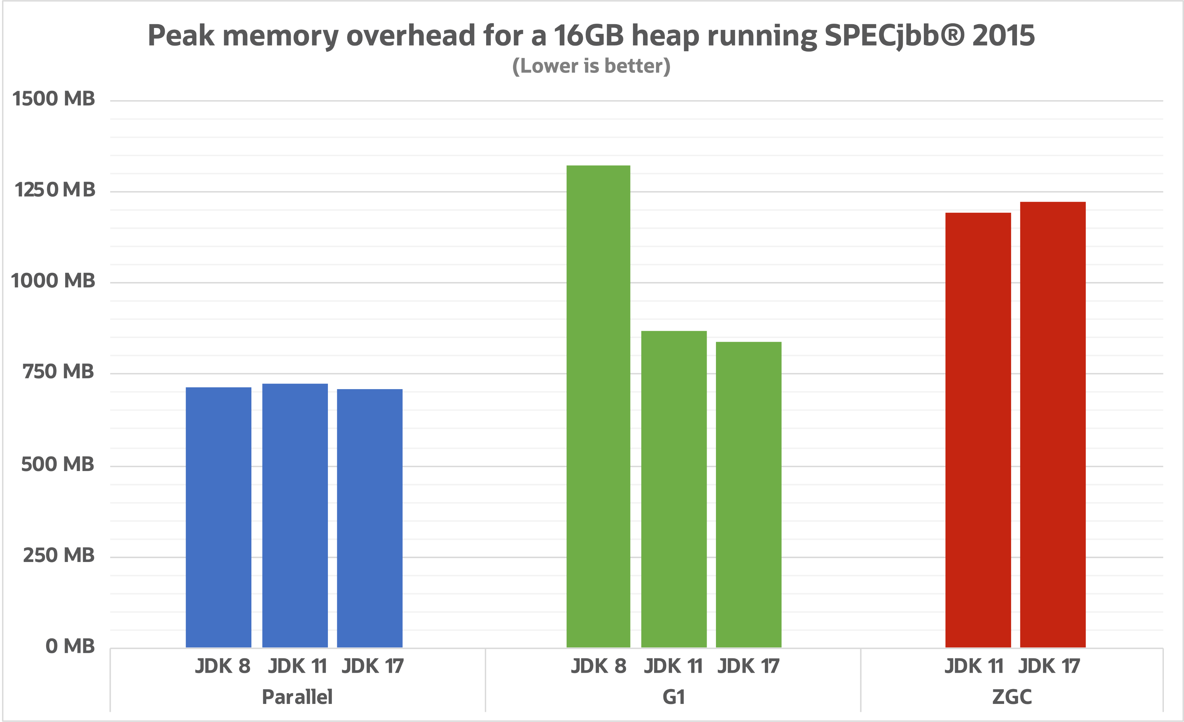
JEP 439: Generational ZGC
https://kstefanj.github.io/2021/11/24/gc-progress-8-17.html
Notes:
But there was a room for significant improvement…

Slide 45
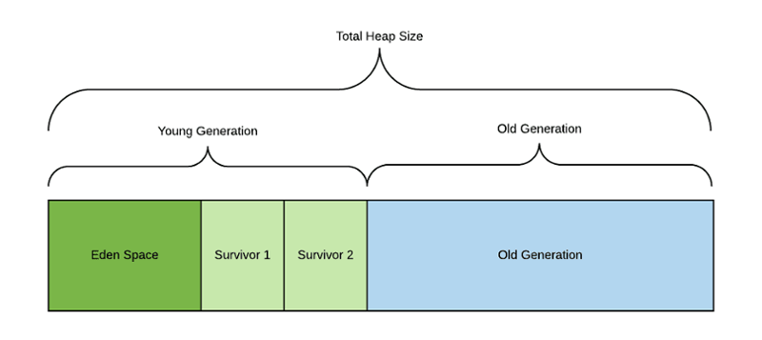
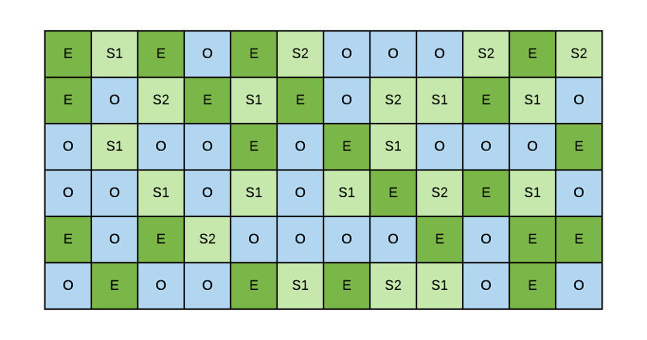
JEP 439: Generational ZGC
Serial GC, Parallel GC, CMS (deprecated) splits heap into two regions:
G1 GC splits heap into a few smaller regions (max 2048):
The weak generational hypothesis states that young objects tend to die young, while old objects tend to stick around.
Notes:
If we take a look at Serial, Parallel GC and CMS collectors: they are splitting the heap into young and old regions and usually young generation is something around two times smaller than old.
(click)
Similarly, G1 splits the heap into a number (typically 2048) smaller heap regions. Each of the regions can be allocated as an Eden, a Survivor or an Old region. The number of regions allocated to either Eden, Survivor or Old is flexible and determined by the GC at runtime.
And the reason is
(click)
Weak-Generational Hypothesis, which posits that many objects die shortly after their creation. It’s called hypothesis, not theorem, because it was derived from observing object allocations/deallocations on a large number of live systems.
The implicit point of most generational GC implementations is to reduce the amount of time that a program pauses for garbage collection by looking at only the youngest generation during a pause, the pause is kept short.
(…)
Okay, looks like generations are beneficial, offers lower risks and lower garbage collection CPU overhead. Why don’t bring them to ZGC? Please welcome:

Slide 46
JEP 439 Generational ZGC
JDK 21

Slide 47
JEP 439: Generational ZGC
ZGC was initially released as a single-generation garbage collector.
Starting with JDK 21, and in addition to single-generation, multi-generation support is now also available in ZGC.
Generations are not enabled by default, so you need a special argument:
-XX:+UseZGC -XX:+ZGenerational
Hazelcast JET benchmarks
 | JDK 20 | JDK 21 – Single generation | JDK 21 – Multi generational
Average | 20 µs | 21 µs | 35 µs
Max | 330 µs | 390 µs | 190 µs
“For the benchmark, the peek native footprint is roughly 350M (for a 4G heap) with Generational ZGC compared to 250M for legacy ZGC. This increase is not too bad given the other performance gains and if we compare it to G1, which also is generational, the difference in this use case is small. G1 has a peak native memory usage around 325M.”
Stefan Johanson, Oracle JDK Engineer
Notes:
What about benchmarks?
You can see small increase of average pause between single and multi-generation in JDK 21. My understanding this is due to synchronization between phases and the fact that we need to track references between generations.
The main metric, however, is maximum pause is decreased two times.
Of course, nothing is given for free. I asked the ZGC developer how the footprint changed with generational enabled and he said that for 4 GB heap it went from 250 MB to 350 MB.
(…)
So it looks like ZGC is finally ready for production, and clearly demonstrates it's main goal - low latency. So if your application could benefit from sub-millisecond GC pauses, I would recommend giving ZGC a try with generations enabled.

Slide 48



What’s next?
JEP 400: UTF-8 by Default
JEP 408: Simple Web Server
JEP 413: Code Snippets in Java API Documentation
JEP 431: Sequenced collections
JEP 439: Generational ZGC
JEP 440: Record patterns
JEP 441: Pattern matching for switch
JEP 444: Virtual threads
Notes:
Switching gears.

Slide 49
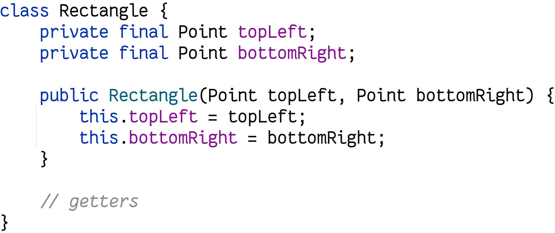
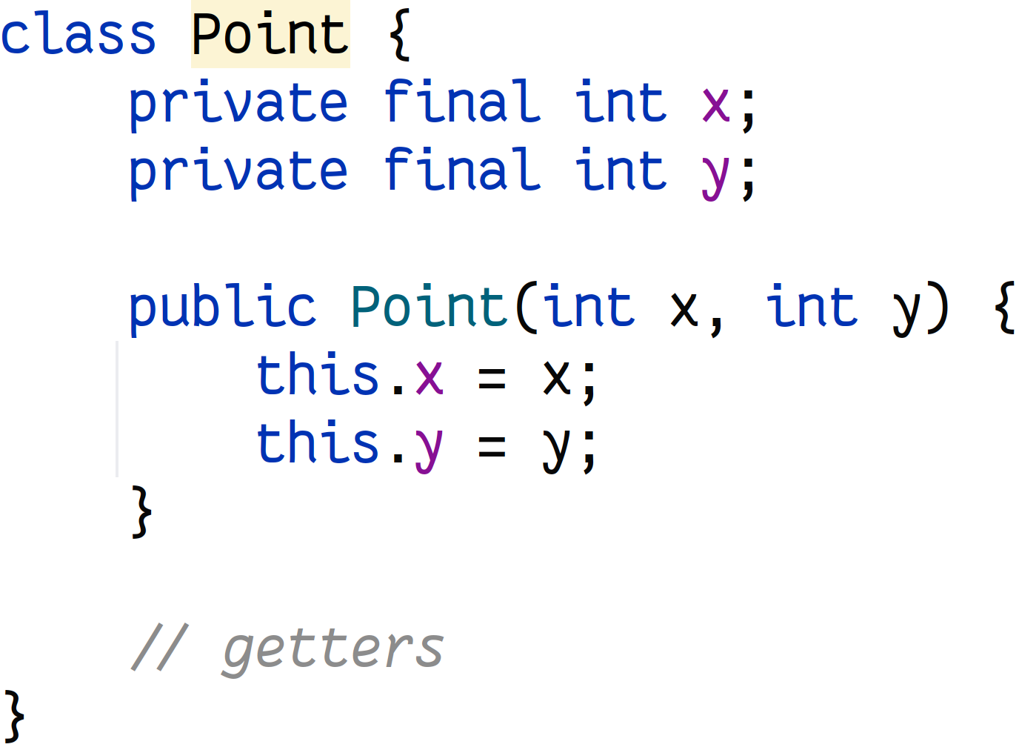
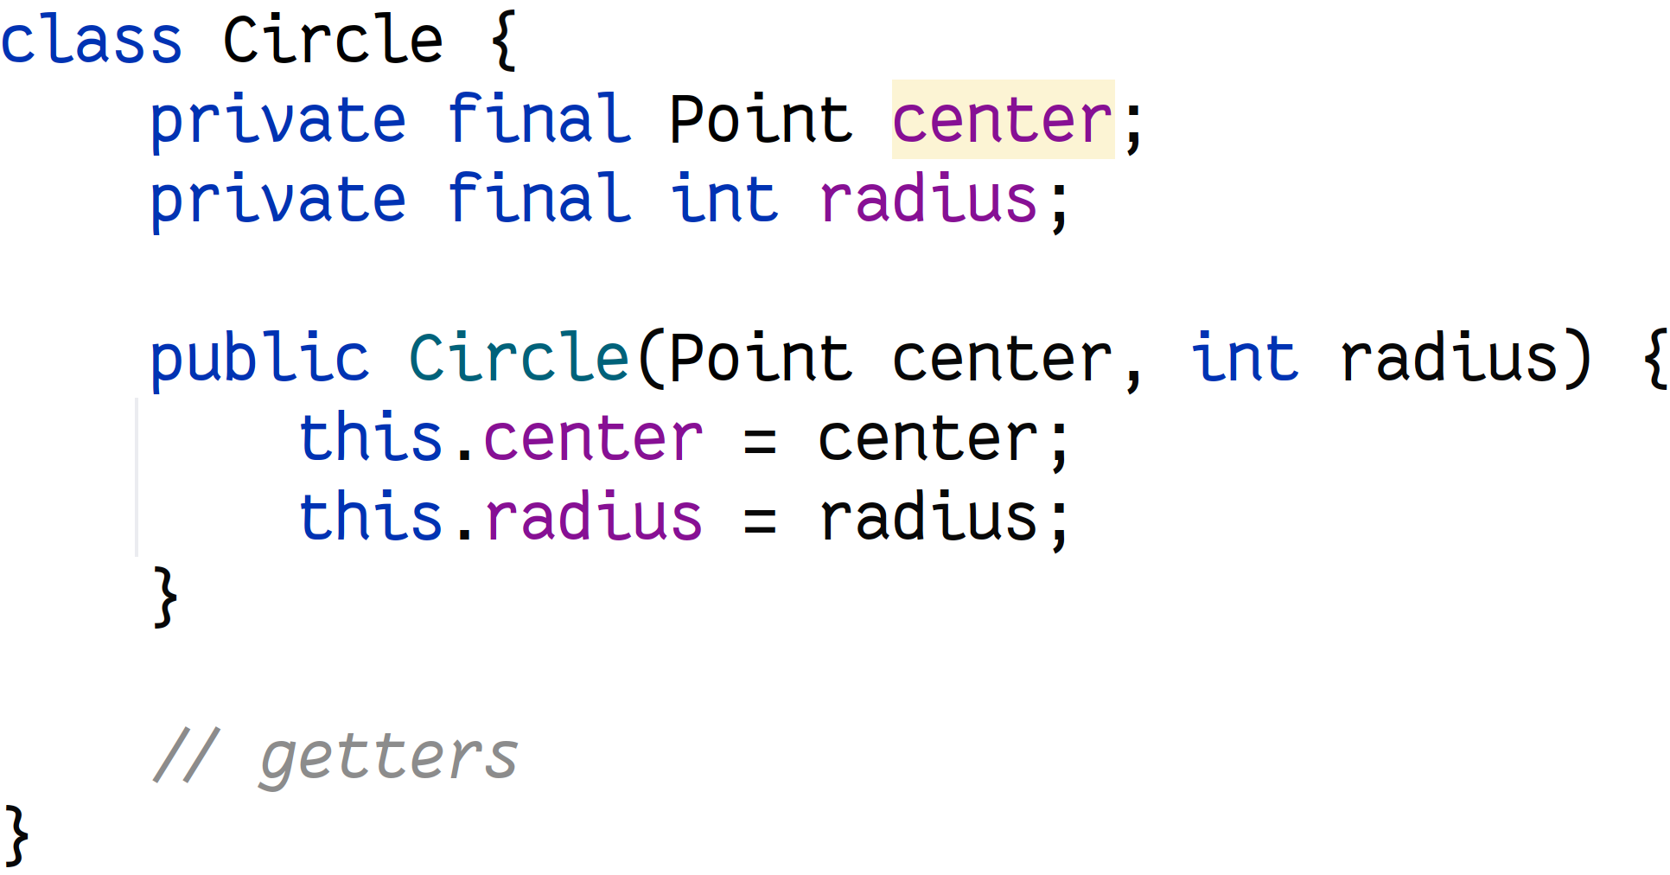
JEP 440: Record patterns
Prior to Java 16
Notes:
Let’s say we need to model Point, Rectangle and Circle. Prior Java 16, there was only one way to define them or may be use Lombok’s @Value annotation.

Slide 50

JEP 440: Record patterns
Notes:
And if we would like to calculate area we could probably create 2 different methods or single one with two instanceof

Slide 51


JEP 440: Record patterns
Record is a class with special state description:
Tuple
Immutable
API derived from state
And can be overridden
Reduce boilerplate
Can be one-liners
Notes:
In JDK 16 we got records and
Record is a class that models a state with following characteristics
(click)
Nominal tuple
(click)
Immutable carrier of data
(click)
Representation and API derived from state description
(click)
You can declare constructors, implement interfaces, add generics
(click)
Implicitly reduce boilerplate, but that was not a goal. Keep in mind record that’s not a syntactic sugar
(click)

Slide 52

JEP 440: Record patterns
Notes:
And thanks to another enhancement in JDK 16 we got pattern matching so we can declare variable along with instanceof.
But that’s not all…

Slide 53




After Java 16 – It is real pattern matching…
Notes:
Besides introducing new variable in switch expression, we can examine contents of the object right into IF expression. Verify correctness of objects.
For example, verify radius and if it’s positive return the result and if negative throw exception
(click)
By the way, this functionality works for both record and normal classes.
(click)
However, it's a bit annoying to write the same variable multiple times... Looking at this, I would like to put it in a separate variable and then use it as in the following example

Slide 54

After Java 16 – Too many “rectangles”
Notes:
But it's already getting a little cumbersome. It's like good old Java. It would be cool if we could somehow benefit from records.
Please welcome….

Slide 55
JEP 440 Record Patterns
JDK 21
Notes:
Record patterns.

Slide 56

Record patten matching – Decompose on fly
We remember that Rectangle and Circle are records. We can decompose them!
Notes:
We remember that Rectangle and Circle are records. Records have components. It means that we can decompose records:
(click)
Right into if expression and
(click)
then use this variables in method body

Slide 57



Record patten matching – We can go deeper…
We can go deeper. Point can be decomposed too…
Notes:
Ok, but Point itself is a record. So it can be decomposed too and we can go deeper
(click to show code)
And assign variable for their components
(click to highlight patterns)
Unfortunately you can not decompose and assign variable to for example to left point.
(click)
The only way is to do partial decomposition.

Slide 58

Record patten matching – Guards
And of course, we can add guards 💂🏽
Notes:
Of course, you can add guards into if expression
(click)
right after decomposition
(click)
Okay, this looks good. What about records with generics? We all remember the pain that type erasure brings. But luckily everything's okay.

Slide 59






Record patten matching – Generic support
Record with generics:

Slide 60


Record patten matching – Mixing records
We can combine records with generics 😎
However, generics with regular classes won’t work 😭
But raw classes work fine 🥴

Slide 61


Record patten matching – Compare size & performance
🆚 Comparison
Size: 111 bytes
Size: 212 bytes
⏱️Performance
10 calls: 0.036 ± 0.001 us/op
100 calls: 0.376 ± 0.042 us/op
1000 calls: 3.680 ± 0.163 us/op
10 calls: 0.035 ± 0.002 us/op
100 calls: 0.444 ± 0.067 us/op
1000 calls: 3.751 ± 0.097 us/op
Notes:
…
Ok, so performance is not affected in any way, but why is the size twice as big?

Slide 62


Record patten matching – Why size differs?
Code
Decompiled by FernFlower

Slide 63



Record patten matching – MatchingExceptionn
Notes:
Okay, MatchException is just a wrapper.

Slide 64

Record patten matching for multiple classes
Notes:
Consider another example. Let’s an addition to Rectangle, Circle, Square we decided to add a Triangle and we decided that we need to calculate a centre of the figure:
(click)
This code benefits from using pattern new instanceof expressions, but it is far from perfect.
Looks cumbersome and the problem is that this approach allows coding errors to remain hidden because we have used an overly general control construct – if statement.
We often want to compare a variable such as obj against multiple alternatives. Java supports multi-way comparisons with switch statements and I would say switch is a perfect match for pattern matching! Please welcome…

Slide 65
JEP 441 Pattern Matching for switch
JDK 21
Notes:
In JEP 441 the power of pattern matching is expanded to Switch statements to reduce boilerplate code and improve readability.

Slide 66

JEP 441: Pattern Matching for switch
Notes:
I rewrote previous example using new switch syntax and together with semantics of this switch expression: the intent of this code is clearer because we are using the right control construct: We are saying, "the parameter obj matches at most one of the following conditions, figure it out and evaluate the corresponding arm."
As a bonus, it is more optimizable; in this case we are more likely to be able to perform the dispatch in O(1) time.
Traditionally, switch statements and expressions throw NullPointerException if the selector expression evaluates to null, so testing for null must be done outside of the switch but here …
(click)
null among the cases.
And here is a thing if obj is null and we have a case null, the switch executes the code associated with that label; without a case null, the switch throws NullPointerException, just as before.
But let’s go back to our previous example with area calculation…

Slide 67

JEP 441: Pattern Matching for switch
Notes:
Here we calculate area of the object and long with type checking we verify correctness of the object by checking that coordinates are valid. Can we do similar with switch? Absolutely …
(click)
Starting form JDK 21, Java language allows when clauses in switch blocks to specify guards to pattern case labels and we will call them guarded cases label, and to the boolean expression as the guard.
Okay, in this example, we verify that radius is a positive double, but what if it’s not? Let’s say zero or negative. Well it fallback into default case label. But we can handle such cases as well. Let’s rewrite it…

Slide 68

JEP 441: Pattern Matching for switch
Notes:
Here we moved negative scenario into separate case and in case of radius equals zero we can simply omit guard, since previous guards cover all possible cases.

Slide 69

Switch patten matching – Compare size & performance
🆚 Comparison
Size: 111 bytes
Size: 260 bytes
⏱️Performance
10 calls: 0.036 ± 0.001 us/op
100 calls: 0.376 ± 0.042 us/op
1000 calls: 3.680 ± 0.163 us/op
10 calls: 0.037 ± 0.001 us/op
100 calls: 0.370 ± 0.023 us/op
1000 calls: 4.648 ± 0.938 us/op
Notes:
If statements was something around 212 bytes, here we got 260. But, as you can see it doesn’t affect performance so much, but the code looks more clear and easy to read.

Slide 70
What’s next?
Notes:
By the way, if we go to previous example, you can see that variable center is not used, but we still have to declare it (click)
Luckily we have JEP 443: Unnamed Patterns and Variables (Preview) which is in preview

Slide 71

JEP 443: Unnamed Patterns and Variables (Preview)
With --enable-preview you can omit unused variables in match expressions:

Slide 72


JEP 441: Pattern Matching for switch
Notes:
Okay final example. In JDK 17, we got sealed classes which provides a more declarative way than access modifiers to restrict the use of a superclass.
We can redesign our hierarchy this way.

Slide 73





JEP 441: Pattern Matching for switch
Notes:
And sealed classes in selector can give us benefits in verifying that switch block is exhaustive.

Slide 74






JEP 441: Pattern Matching for switch

Slide 75





What’s next?
JEP 400: UTF-8 by Default
JEP 408: Simple Web Server
JEP 413: Code Snippets in Java API Documentation
JEP 416: Reimplement Reflection with Method Handles
JEP 431: Sequenced collections
JEP 439: Generational ZGC
JEP 440: Record patterns
JEP 441: Pattern matching for switch
JEP 444: Virtual threads

Slide 76








JEP 444: Virtual threads

Slide 77

JEP 444: Virtual threads
Pulling a new order takes ≈ 450 ± 50 ms
Performance of 10 000 requests with 50 concurrent users using Apache Benchmark (ab):
.\ab.exe -n 10000 -c 50 http://orderservice:8080/order
50 users: 90.838 seconds 110 RPS
100 users: 45.889 seconds 217 RPS
200 users: 23.304 seconds 429 RPS
300 users: 23.197 seconds 431 RPS
500 users: 23.333 seconds 428 RPS
What’s happened after 200 users? 🤔
Notes:
(What’s happened after 200 users?)
Our throughput doesn’t increase with larger number of concurrent users. Why? Looks like quite simple, when you have an incoming request you create a thread for it and handle it.
However threads are expensive as usual when expensive resources we pull them so we create thread pools. That’s why by default embedded Tomcat has only 200 worker threads, but this number can be increased.
(after screenshot)
But that’s not only the case. We also use threadpools for protection, kind of rate limiting. We say that bandwith of our service is 200 concurrent requests. That’s it.
However, not only throughput affected by bounded threadpools.

Slide 78






JEP 444: Virtual threads
Beyond throughput, another problem is latency.
Latency is sum of:
duration while the request is queued [T1; T2]
the amount of time it takes to process the request itself [T2; T3]
Notes:
What other options do we have?

Slide 79







JEP 444: Virtual threads
Asynchronous approach
Use available in JDK Java NIO:
Or use other frameworks:
Low-level: Netty
High-level: Reactor, Vertex
Notes:
(after
(before frameworks))

Slide 80


JEP 444: Virtual threads
Synchronous
Asynchronous
Developer 😊
Hardware 😞
Developer 😞
Hardware 😊
✅ Easy to read
✅ Fits well with language (control flow, exceptions)
✅ Fits well with tooling (debuggers, profilers)
But…
❌ A costly resource
✅ Scalable
But…
❌ Hard to read
❌ Lost context: hard to debug and profile
❌ Intrusive (impossible to migrate)
Notes:
Writing asynchronous code is extraordinary difficult. Avoiding the need to write application logic in asynchronous style is key to improving the quality and stability of an application.
Looks like we need

Slide 81
















JEP 444: Virtual threads
New construct to combine sync & async
Users write synchronous code as before, the JDK executes it asynchronously
Developer 😊
Hardware 😊
Executing thread is
handling another
request

Slide 82









JEP 444: Virtual threads
Notes:
Or let’s take a look on another example
(final)
Before JDK 21 this looks unrealistic… However in JDK we got a new instrument…

Slide 83
JEP 444 Virtual Threads
JDK 21

Slide 84

JEP 444: Virtual threads
Notes:
Let me introduce new construct which is called Continuation to be more precisely “one-shot delimited continuation”. Treat it as a wrapper of Runnable which can pause itself by calling yield and then continued externally from last yielded point using run

Slide 85


JEP 444: Virtual threads

Slide 86




















JEP 444: Virtual threads
Continuation
+
Scheduler
=
Yields when the task needs to block
Thread pool
ForkJoinPool
Is continued when the task is ready to continue
Async mode
Implemented on VM level
Implemented in Java

Slide 87





JEP 444: Virtual threads
Green threads
(N:1 threading)
Platform threads
Virtual threads
java.lang.Thread
java.lang.VirtualThread
>2KB metadata
1MB stack
Typically, a thin wrapper around an OS thread
N:N threading
200-300 bytes of metadata
Pay-as-you-go stack in the Java heap
Not tied to a particular OS thread
M:N threading
Notes:
(…)
Now we know, that virtual threads are essentially continuations running on platform threads called as carrier threads from their perspective.

Slide 88




JEP 444: Virtual threads
Starting a virtual thread to run a piece of code
Notes:
(click)
First of all, Virtual thread is hidden and you can not create it via constructor.

Slide 89


JEP 444: Virtual threads
Starting a virtual thread to run a piece of code
Notes:
New builder API

Slide 90

JEP 444: Virtual threads
ExecutorService with policy to start a new virtual thread for each task

Slide 91
JEP 444: Virtual threads
Open questions:
How virtual thread suspends and releases carrier (platform) thread?
What to do with a call stack?
Notes:
Get back to our example with Order controller. Let’s say we are running the server on virtual threads.
But how virtual thread suspends? Is it magic? How it understands that thread should be yielded and then resumed?

Slide 92


JDK 11
JEP 444: Virtual threads
JDK 21
Notes:
Back to our first question. If we run our application on JDK 11
Please notice Poller and LookSupport.park() at the bottom

Slide 93






JEP 444: Virtual threads
Notes:
(…)
But what happens in LockSupport.park() and unpark()…

Slide 94


JEP 444: Virtual threads
LockSupport is main building block for virtual and platform threads
Notes:
LockSupport is main building block. Park and unpark support both types
(…)
So technically, locks work in the same way…
What about sleeping?

Slide 95

JEP 444: Virtual threads
JDK 11
JDK 21

Slide 96

JEP 444: Virtual threads
Virtual thread “sleep” = Continuation.yield(…) + scheduled run()

Slide 97
JEP 444: Virtual threads
🪄No magic!
JDK developers reimplemented most of the blocking operations with park() + unpark()
networking stack (Socket API)
locks (ReentrantLock, Semaphore, etc.)
thread operations (sleep, interrupt)
But there are some limitations:
synchronized blocks
native stackframes
The open question: how carrier threads are released? What happens with stack?

Slide 98





JEP 444: Virtual threads
Notes:
What happens with stack during “yielding”?

Slide 99



JEP 444: Virtual threads
Notes:
What happens when we unpark the thread?
(…)
Why only one frame and not all? Consider and example:

Slide 100


JEP 444: Virtual threads
Notes:
If we will copy all frames that will be time consuming

Slide 101


JEP 444: Virtual threads
Notes:
That’s why when we are copy the frame we insert barrier and patch return address.

Slide 102



JEP 444: Virtual threads
Notes:
Once we received the order and added to collection we are starting a new iteration and continue till next yild

Slide 103




JEP 444: Virtual threads
Notes:
And on next yield we are create a new chunk? Why?
Let’s recall how garbage collection works…
(…)
Okay, that’s it. Just to recap: if you run platform thread it will block, if you run virtual thread and virtual thread

Slide 104
JEP 444: Virtual threads
Common misconceptions
Thinking that virtual threads are faster threads
Replacing platform threads with virtual threads rather than tasks with virtual threads
Changing the ThreadFactory for a thread pool, thus pooling virtual threads
Pinning issues and assuming that all uses of monitors must be replaced
Using framework/libraries that make heavy use of thread locals and assume running on a pooled thread
Ignoring scalability of other components: thinking that “more Threads” is the solution to any scalability problems:
Databases
Network
Locks
Caches

Slide 105


JEP 444: Virtual threads
Migration guide
Move to simpler blocking/synchronous code
Migrate tasks to virtual threads, not platform threads to virtual threads
Use Semaphores or other tools to limit concurrency
Don’t cache expensive objects in thread locals
Avoid lengthy and frequent pinning

Slide 106
That’s all folks!
JEP 400: UTF-8 by Default
JEP 408: Simple Web Server
JEP 413: Code Snippets in Java API Documentation
JEP 431: Sequenced collections
JEP 439: Generational ZGC
JEP 440: Record patterns
JEP 441: Pattern matching for switch
JEP 444: Virtual threads

Slide 107

Next steps?

Slide 108



Questions?

